Slide 1
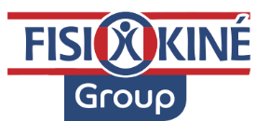

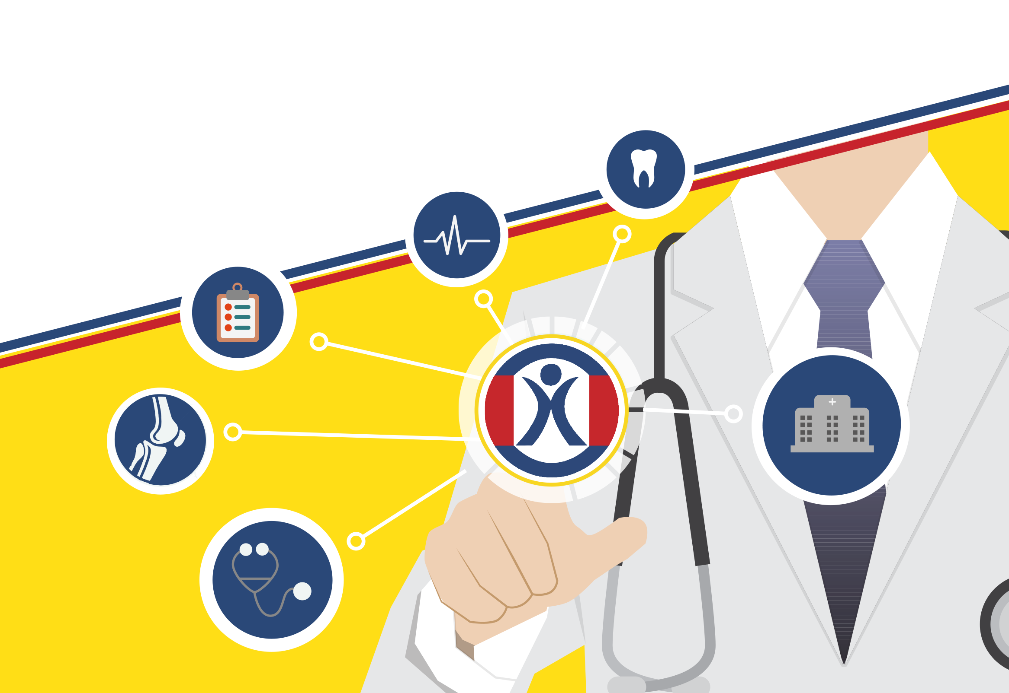
Thermae 4.0: a business opportunity in for thermal companies
Kassis Anis Pt – OMT
CEO FISIOKINE GROUP
Batumi October 2018
Notes:
Thank you to femtec, professor solimene
My nme is…..
I am a phisical therapist and i am ceo of fisiokine group….

Slide 2


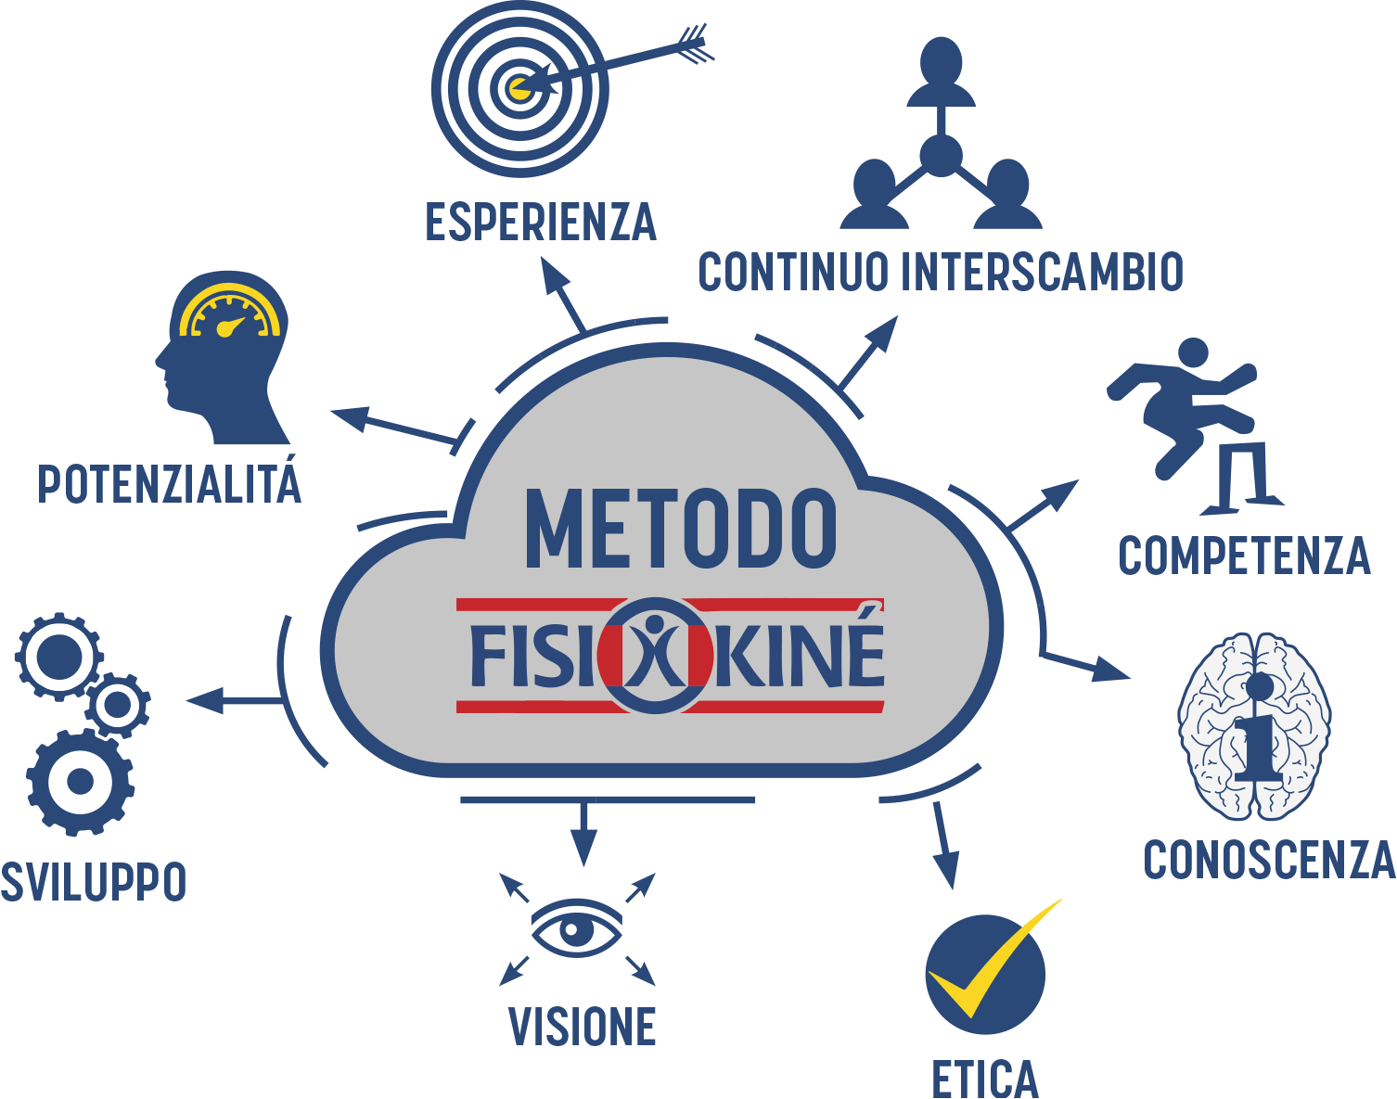
Who we are
Fisiokine was estabilished in Correggio (RE) in 2005 to satisfy the increasingly frequent physiotherapeutic and orthopedic diagnostic and treatment needs within the territory.
2010 Fisiokiné Scandiano (Re)
2012 Fisiokiné Reggio Emilia (Re)
2013 Fisiokiné Formigine (Re)
2014 Fisiokiné Rubiera (Re)
2015 Fisiokiné Pesaro (Pu) e Bagnolo (Re)
2017 Fisiokiné Soliera
2018 Fisiokiné Morbegno (SO)

Slide 3


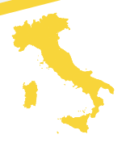

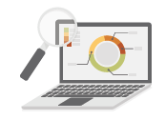



Network
Tomorrow
Today
2006
9 MEDICAL CENTERS OWNED
(4 under development)
START
85.000 HEALTHCARES
PERFORMED EVERY YEAR
STUDY GROUP
FOR NEW PROJECTS
130 COLLABORATORS
Doctors, physiotherapists and nationally and internationally renowned healthcare personnel
MORE THAN 6M € ANNUAL TURNOVER
(19% ANNUAL GROWTH PER CENTER)
1000 POST SURGICAL REHABILITATIONS

Slide 4
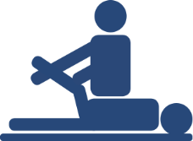

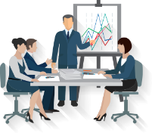

Our Team
60 physiotherapists (mainly OMT)
24 administrative staff and receptionists
6 marketing operator strategists
+100 specialized doctors for 20 different specialities
Notes:
Continuerei con le icone piu che con immagini

Slide 5
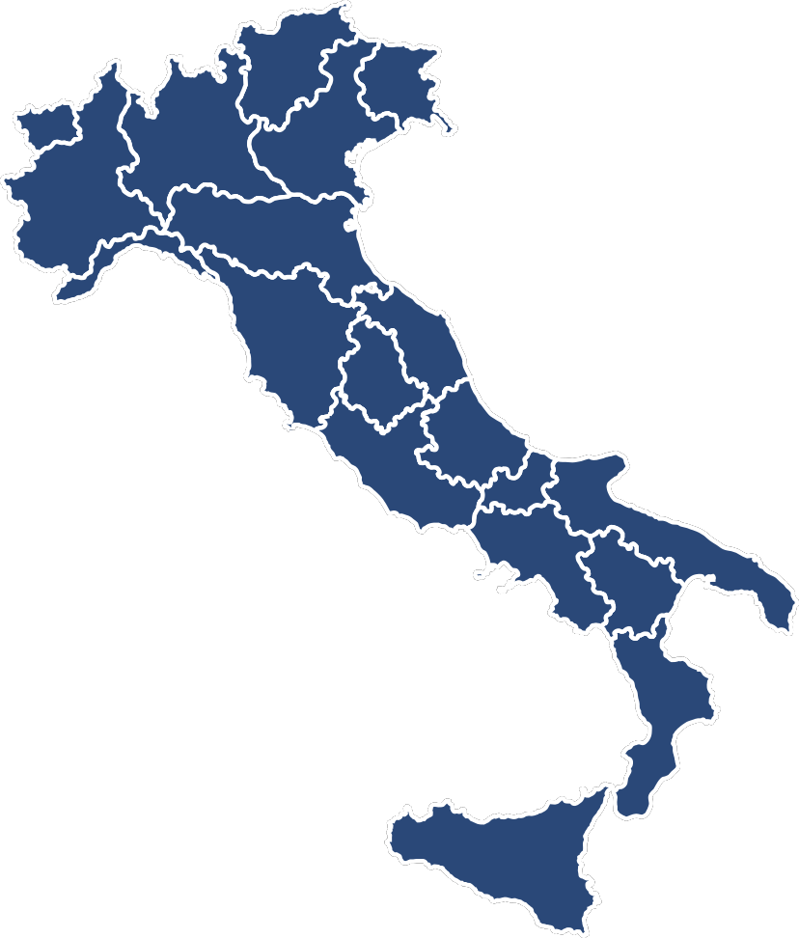
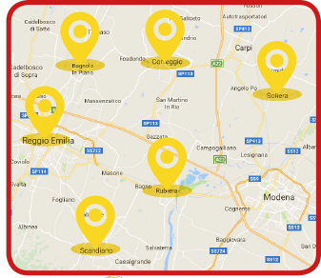
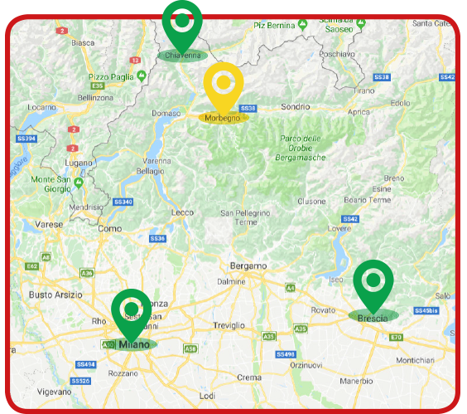
Fisiokinè in Italy
1
2
4
6
2
1
        FISIOKINÈ CORREGGIO - Correggio (RE)
        FISIOKINÈ SCANDIANO - Scandiano (RE)
        FISIOKINÈ REGGIO EMILIA - Reggio Emilia (RE)
        FISIOKINÈ RUBIERA - Rubiera (RE)
        FISIOKINÈ PESARO - Pesaro (PU)
        FISIOKINÈ BAGNOLO - Bagnolo in Piano (RE)
        FISIOKINÈ SOLIERA - Soliera (MO)
        FISIOKINÈ MORBEGNO - Morbegno (SO)
        NEXT OPENINGS
Brescia
Milano
Rimini
Chiavenna
Napoli
Notes:
Cercherei un modo per visualizzare i nostri centri, presenti e futuri, magari con una cartina

Slide 6
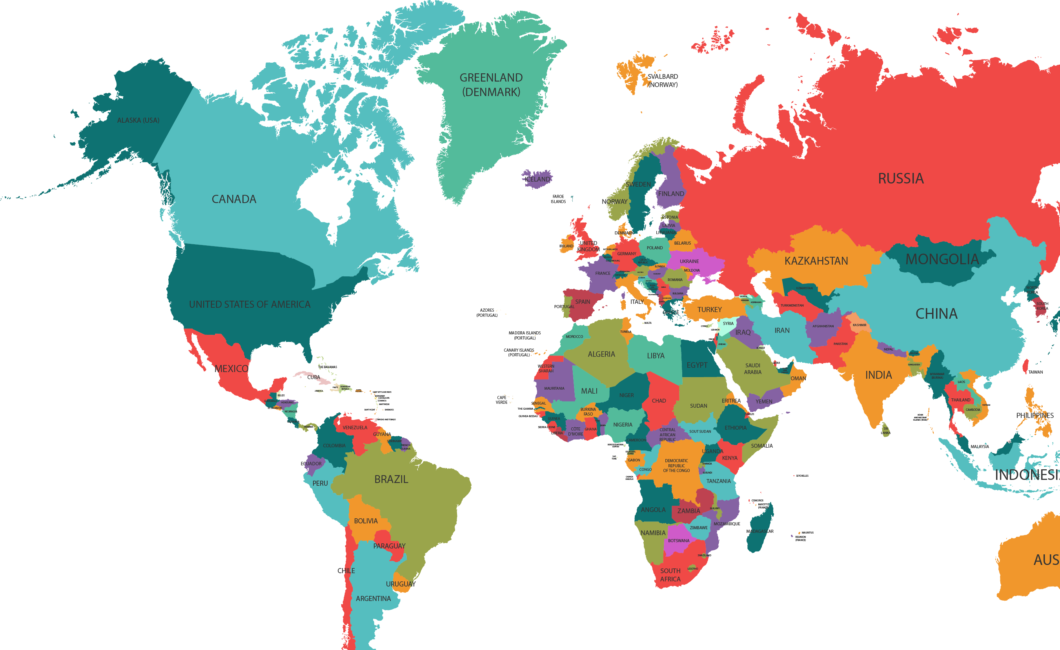

Ongoing Projects Abroad
FISIOKINÉ Caucasus
FISIOKINÉ Tirana
FISIOKINÉ Tunisi
FISIOKINÉ San Paolo
FISIOKINÉ Riad
FISIOKINÉ Moscow (3 projects)
Notes:
But we also have several projecta broad where we work wiht a turn key solutions for investor as i will tell you later

Slide 7


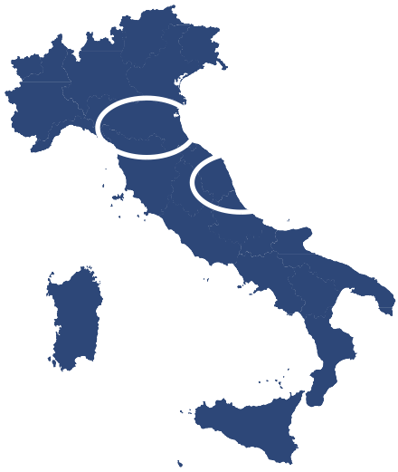
Community
Our working method is valued nationally at all levels:
We are Internship Centers for University of Reggio Emilia, Bologna, Milan and Pesaro.
We also are Reference Centers for top Sports Federations, and in particular we take care of Basketball, Ice Hockey and Volleyball olympic athlets.

Slide 8
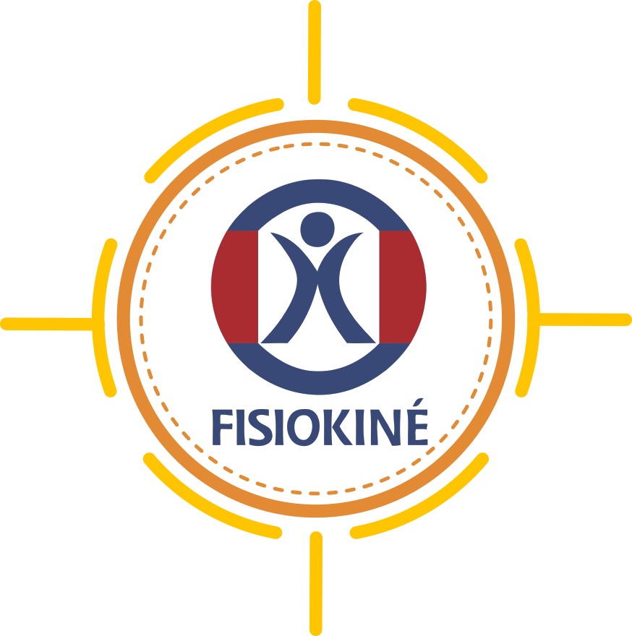
Our Services
REHABILITATION
POLYCLINICS
DENTISTRTY
DIAGNOSTIC
Notes:
Il senso di questa diapositiva è qiella di far vedere i nostri servizi e che questi in qualche modo sono collegati

Slide 9
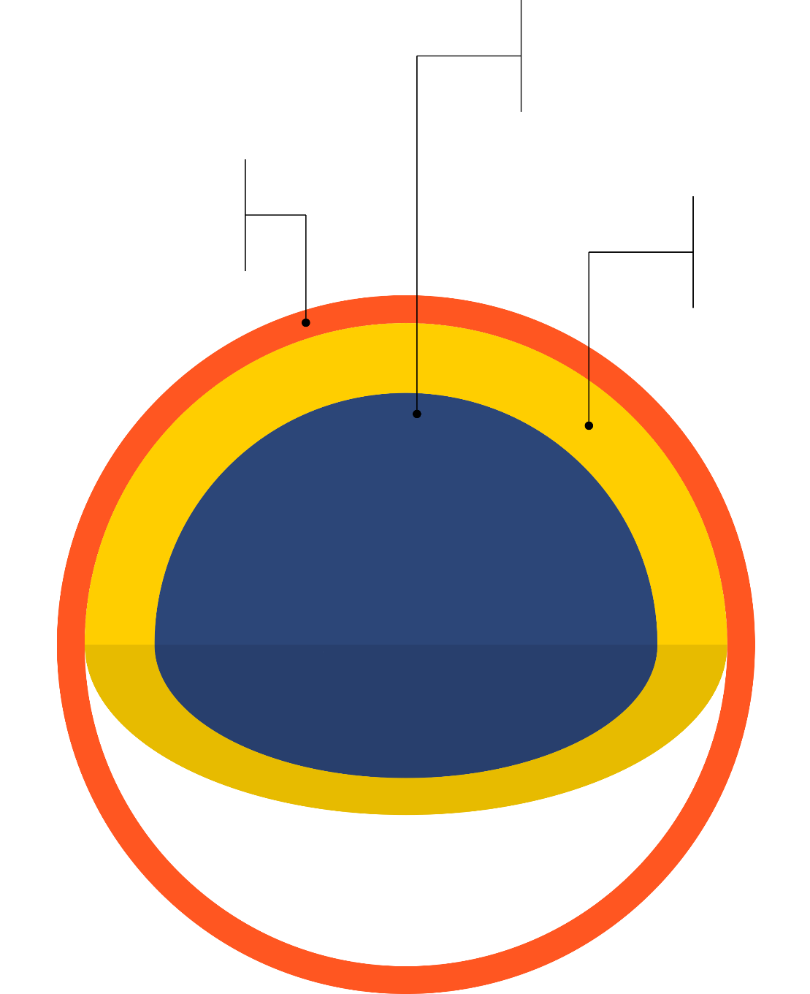
Fisiokinè Core Businnes
REHABILITATION
DENTISTRY
DIAGNOSTICS
POLICLINIC
10%
20%
70%
Notes:
Questa diapositiva serve per far capire cheil core businessi di fisiokine è la fisioterapia

Slide 10
Rehabilitation:
Working Areas
Cardiometabolic
After surgery
Conservative
Orthopedic
and trauma
After surgery
Pain management (spinal pain)
Neurological
Central lesions
Peripheral lesions
Sports
Trauma
Recovery on the pitch

Slide 11
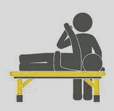
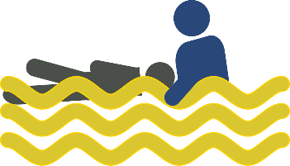
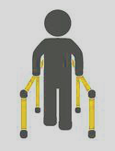
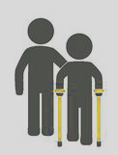
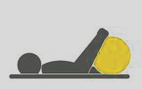
Rehabilitation: instruments
Manual Theraphy
Hydrotherapy
High Technology
Physical Therapy
Therapeutic and Rehab excercises
Notes:
But our main specialization is in hydrotherapy

Slide 12
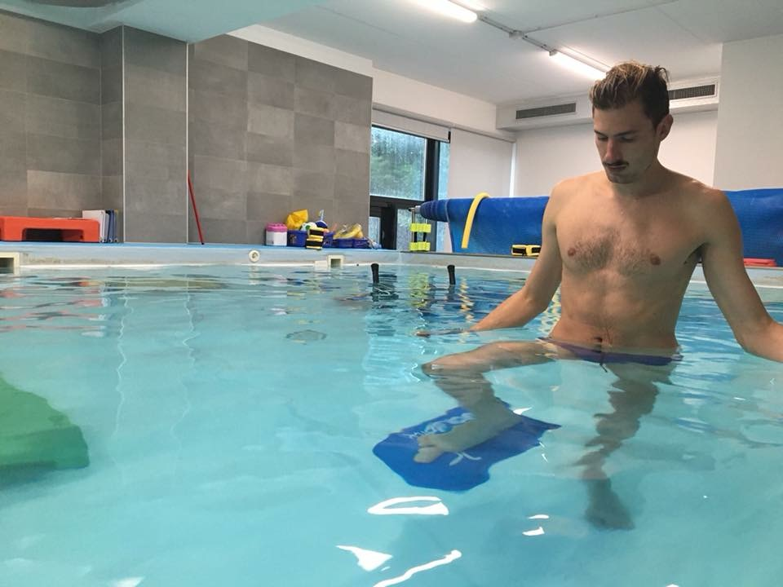
A
Hydrotherapy
Hydrotherapy is a physiotherapy treatment which uses the properties of water in order to achieve specific and therapeutic goals.
It can be offered independently or to complementing existing therapies.
It can be used to treat a multitude of different conditions:
sports injuries,
post-operative and orthopedic conditions,
spinal pain and/or injuries,
neurological conditions,
cardio-respiratory problems,
balance dysfunction
arthritis and aged care.
Notes:
Continuerei con le icone piu che con immagini

Slide 13
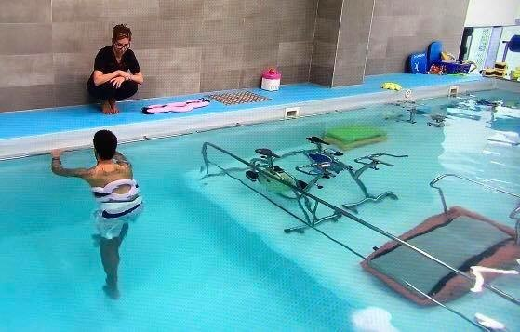
Rehabilitation: hydrotherapy
High specialization of staff and structure
Integrated protocols
Notes:
But to have a successfull work in water you need

Slide 14
A
Hydrotherapy effects
Promotes a sense of well-being (extremely pleasant)
Reduces pain and stiffness in the joints
Stimulates coordination and balance
Tones muscles with lower stress on joints
Encourages a safer ad faster recovery
Prevents deterioration (fall prevention)
Helps relearning motor skills
Facilitates the desired movement patterns
Provides beneficial organic effects (stress, obesity,..).
Notes:
Continuerei con le icone piu che con immagini

Slide 15
A
Balneotherapy effects
Use of pharmaceutical properties of thermal water:
Pain relief and anti inflamatory efect
Helps tissue repair
Changes hormons balance
Helps cardiopulmonary system
…..
Notes:
But we are here because everybody knows the effect of specific thermal water that are

Slide 16
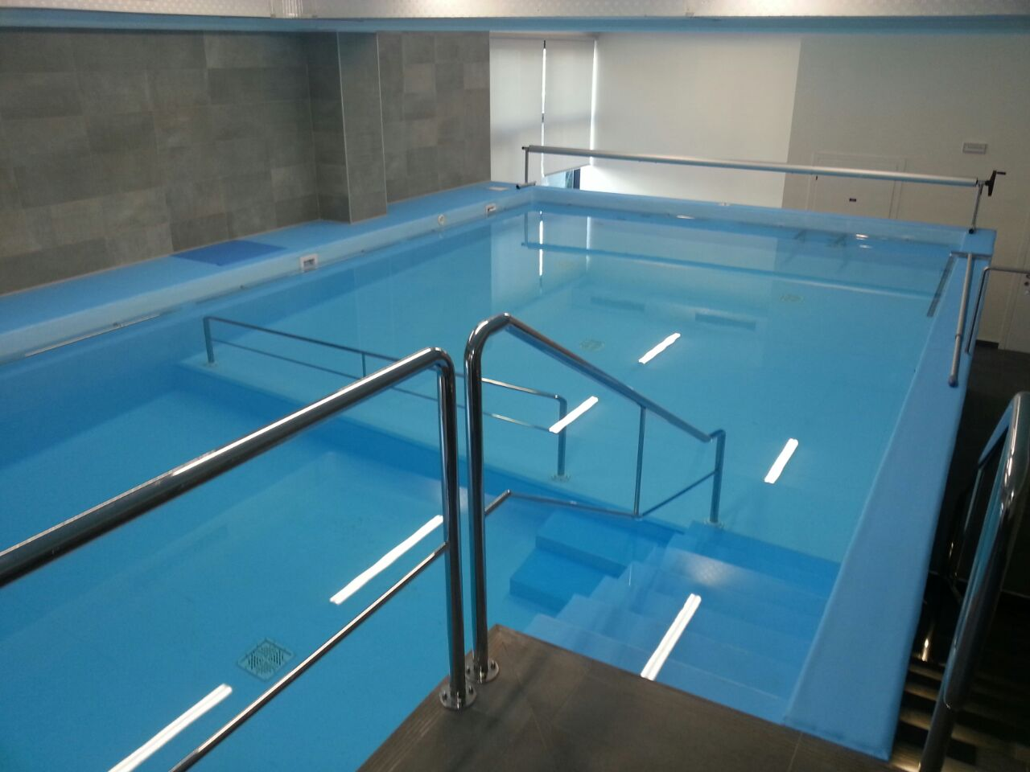
A
Crenotherapy: from pool water to termal water
Balneotherapy —> therapeutic use of bathing agents: mineral and thermal waters
Hydrotherapy —> use of the water for the physiotherapeutic rehabilitation
IDROCRENOTHERAPY
Notes:
So if we add the benefits of balneotherapy to hydroterapy we can talk about

Slide 17
THERAPEUTIC EFFECT =
Hydrotherapy effects
+
Warm water
+
Water’s chemical properties
Notes:
Summing up we can say that

Slide 18
Rehabilitation following ACL Reconstruction (2017)
“Faster retrieval of knee function following aquatic rehabilitation would prevent both short-term risk of lesions of the contralateral limb due to overcompensation and long-term risk of surgery due to osteoarthritis.”
Peultier-Celli, L., Mainard, D., Wein, F., Paris, N., Boisseau, P., Ferry, A., … Perrin, P. (2017). Comparison of an Innovative Rehabilitation, Combining Reduced Conventional Rehabilitation with Balneotherapy, and a Conventional Rehabilitation after Anterior Cruciate Ligament Reconstruction in Athletes. Frontiers in Surgery, 4, 61.
Spa Therapy and Osteoarthritis (2016)
“This systematic review of balneotherapy for OA shows that the treatment delivered in spa centres across Europe and the Middle East improves symptoms.”
Forestier, R., Forestier, F. B. E., & Francon, A. (2016). Spa therapy and knee osteoarthritis: a systematic review. Annals of physical and rehabilitation medicine, 59(3), 216-226.
Notes:
Continuerei con le icone piu che con immagini

Slide 19
Stroke Rehabilitation (2014)
“These findings demonstrate that the use of balneotherapy is an effective non-pharmacological anti-spastic treatment that might facilitate stroke rehabilitation.”
Matsumoto, S., Shimodozono, M., Etoh, S., Noma, T., Uema, T., Ikeda, K., ... & Kawahira, K. (2014). Anti-spastic effects of footbaths in post-stroke patients: A proof-of-principle study. Complementary therapies in medicine, 22(6), 1001-1009.
Exercise Program on Functional Strength and Performance of Older Adults (2012)
“A short-term aquatic exercise program with multidimensional intervention strategies will significantly enhance functional abilities in older adults when compared to a functionally matched active control group. “
Kieffer, H. S., Lehman, M. A., Veacock, D., & KORKUCH, L. (2012). The effects of a short-term novel aquatic exercise program on functional strength and performance of older adults. International journal of exercise science, 5(4), 321.
Notes:
Continuerei con le icone piu che con immagini

Slide 20
Effectiveness of balneotherapy and spa therapy for the treatment of chronic low back pain (2015)
“All reviewed trials reported that balneotherapy was superior in long term to tap water therapy in relieving pain and improving function”
“Spa therapy combining balneotherapy with mud pack therapy and/or exercise therapy, physiotherapy, and/or education was effective in the management of low back pain”
Karagülle, M., & Karagülle, M. Z. (2015). Effectiveness of balneotherapy and spa therapy for the treatment of chronic low back pain: a review on latest evidence. Clinical rheumatology, 34(2), 207-214.
Notes:
Continuerei con le icone piu che con immagini

Slide 21
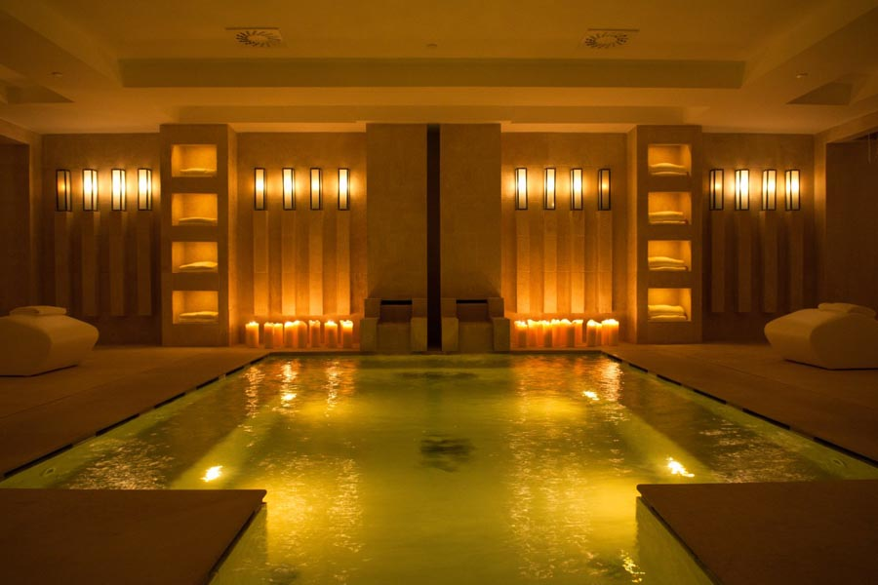
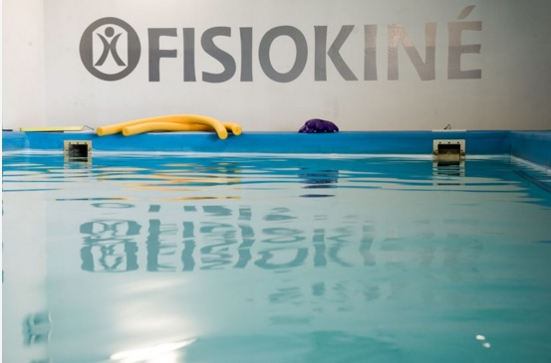
A
Crenoterapy: a business opportunity
FROM a classical Spa model
TO a higly specialized crenotherapy rehabilitation center
Notes:
Starting from this scientific datas and OUR EXPERIENCE WE PUT TOGETHER A PROJECT FOR ENTREPRENEUR THAT WANT TO CHENGE A BUSINESS MODEL

Slide 22

Fisiokiné Franchising
Notes:
And this is what my company does. Transfer knowledge in protocols, managing and way of working in phisical therapy and in particular in water rehabilitation

Slide 23
A
Crenoterapy: a business opportunity
To convert to high level physio center
Technology
Design
Management
Training
Notes:
Dottor boiron tecnologia

Slide 24
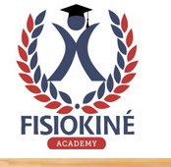
Franchising Project: the training
Your turn-key Medical Center
Medical and administrative Personnel Training in Fisiokine Academy
1°
2°
3°
Step One:
Fisiokine Staff
to train your Personnel in Italy
Step Two:
Fisiokine Staff at your Center to follow the start-up.
Follow up:
Fisiokine Staff periodically verify the functioning of your Center

Slide 25
Franchising Project
1°
2°
STEP ONE:
Training in one of our Centres for the physiotherapists Staff with lessons about our protocols and practical demonstrations.
All this process will be under the supervision of our Dedicated Project Manager.
STEP TWO:
Our Project Manager will follow all the physiotherapists in the first months of the new Center start-up phase to guarantee a correct execution of the procedures and protocols.
FOLLOW UP
Our Project Manager will follow the Physio Staff in the new Centers for 2 more years and will be visiting on site periodically. That will ensure a contiunous control and check of the procedures and exchange feedbacks.
Notes:
Questi sono i concetti da esprimere.

Slide 26


We are looking for INVESTORS OR PARTNERS
who are willing to invest in the healthcare and rehabilitation businness.
We give support for:
Organization and startup of:
Design
Integrated Medical Centers
High-Level specialists in:
Technology
Dentistry, aesthetics, and
bariatric Surgery
Fisiokine "Care” working method:
Training
Managment control
and marketing

Slide 27

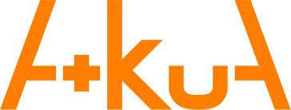

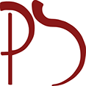
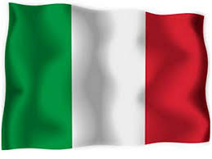
Partners
GRUPPO SAN DONATO
First Italian hospital group
AKUA
Italian company for pool, spa and thermal building
MED
Design and construction of hospital departments
MAURO AGUZZOLI
Architect, specialized in medical centers
ITALIAN MEDICAL DEVICES
A team of Italian manufacturers ready to provide the best technology
Notes:
So we built a team of italian company that have the aim to support theinvestor

Slide 28
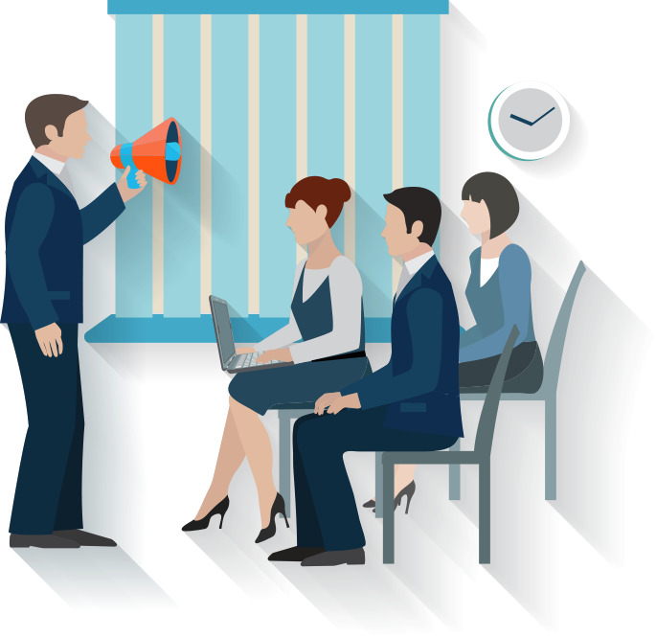
Added Services
Structure Design and Project
Personnel Selection
Selection for medical and diagnostic equipment suppliers
Managment and administrative Staff Training
Medical Staff Training
Marketing Strategists Training
Trademark concession
Managment Software concession
Managment Control
Notes:
Aggiungere icone o immagini

Slide 29
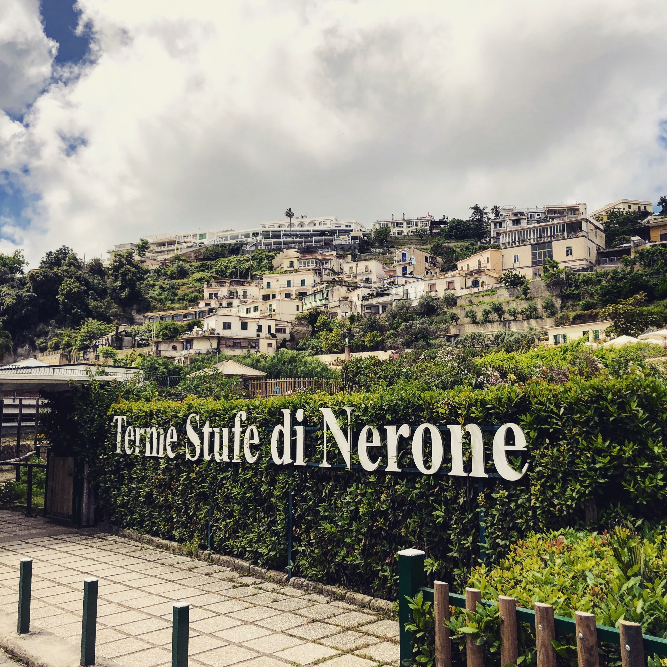
Fisiokine and thermalism; a case report
Historical italian Thermal Plant (built in second century AC)
15.000 square meters
salt-bromine-iodine water at 74°C
Notes:
Aggiungere icone o immagini

Slide 30
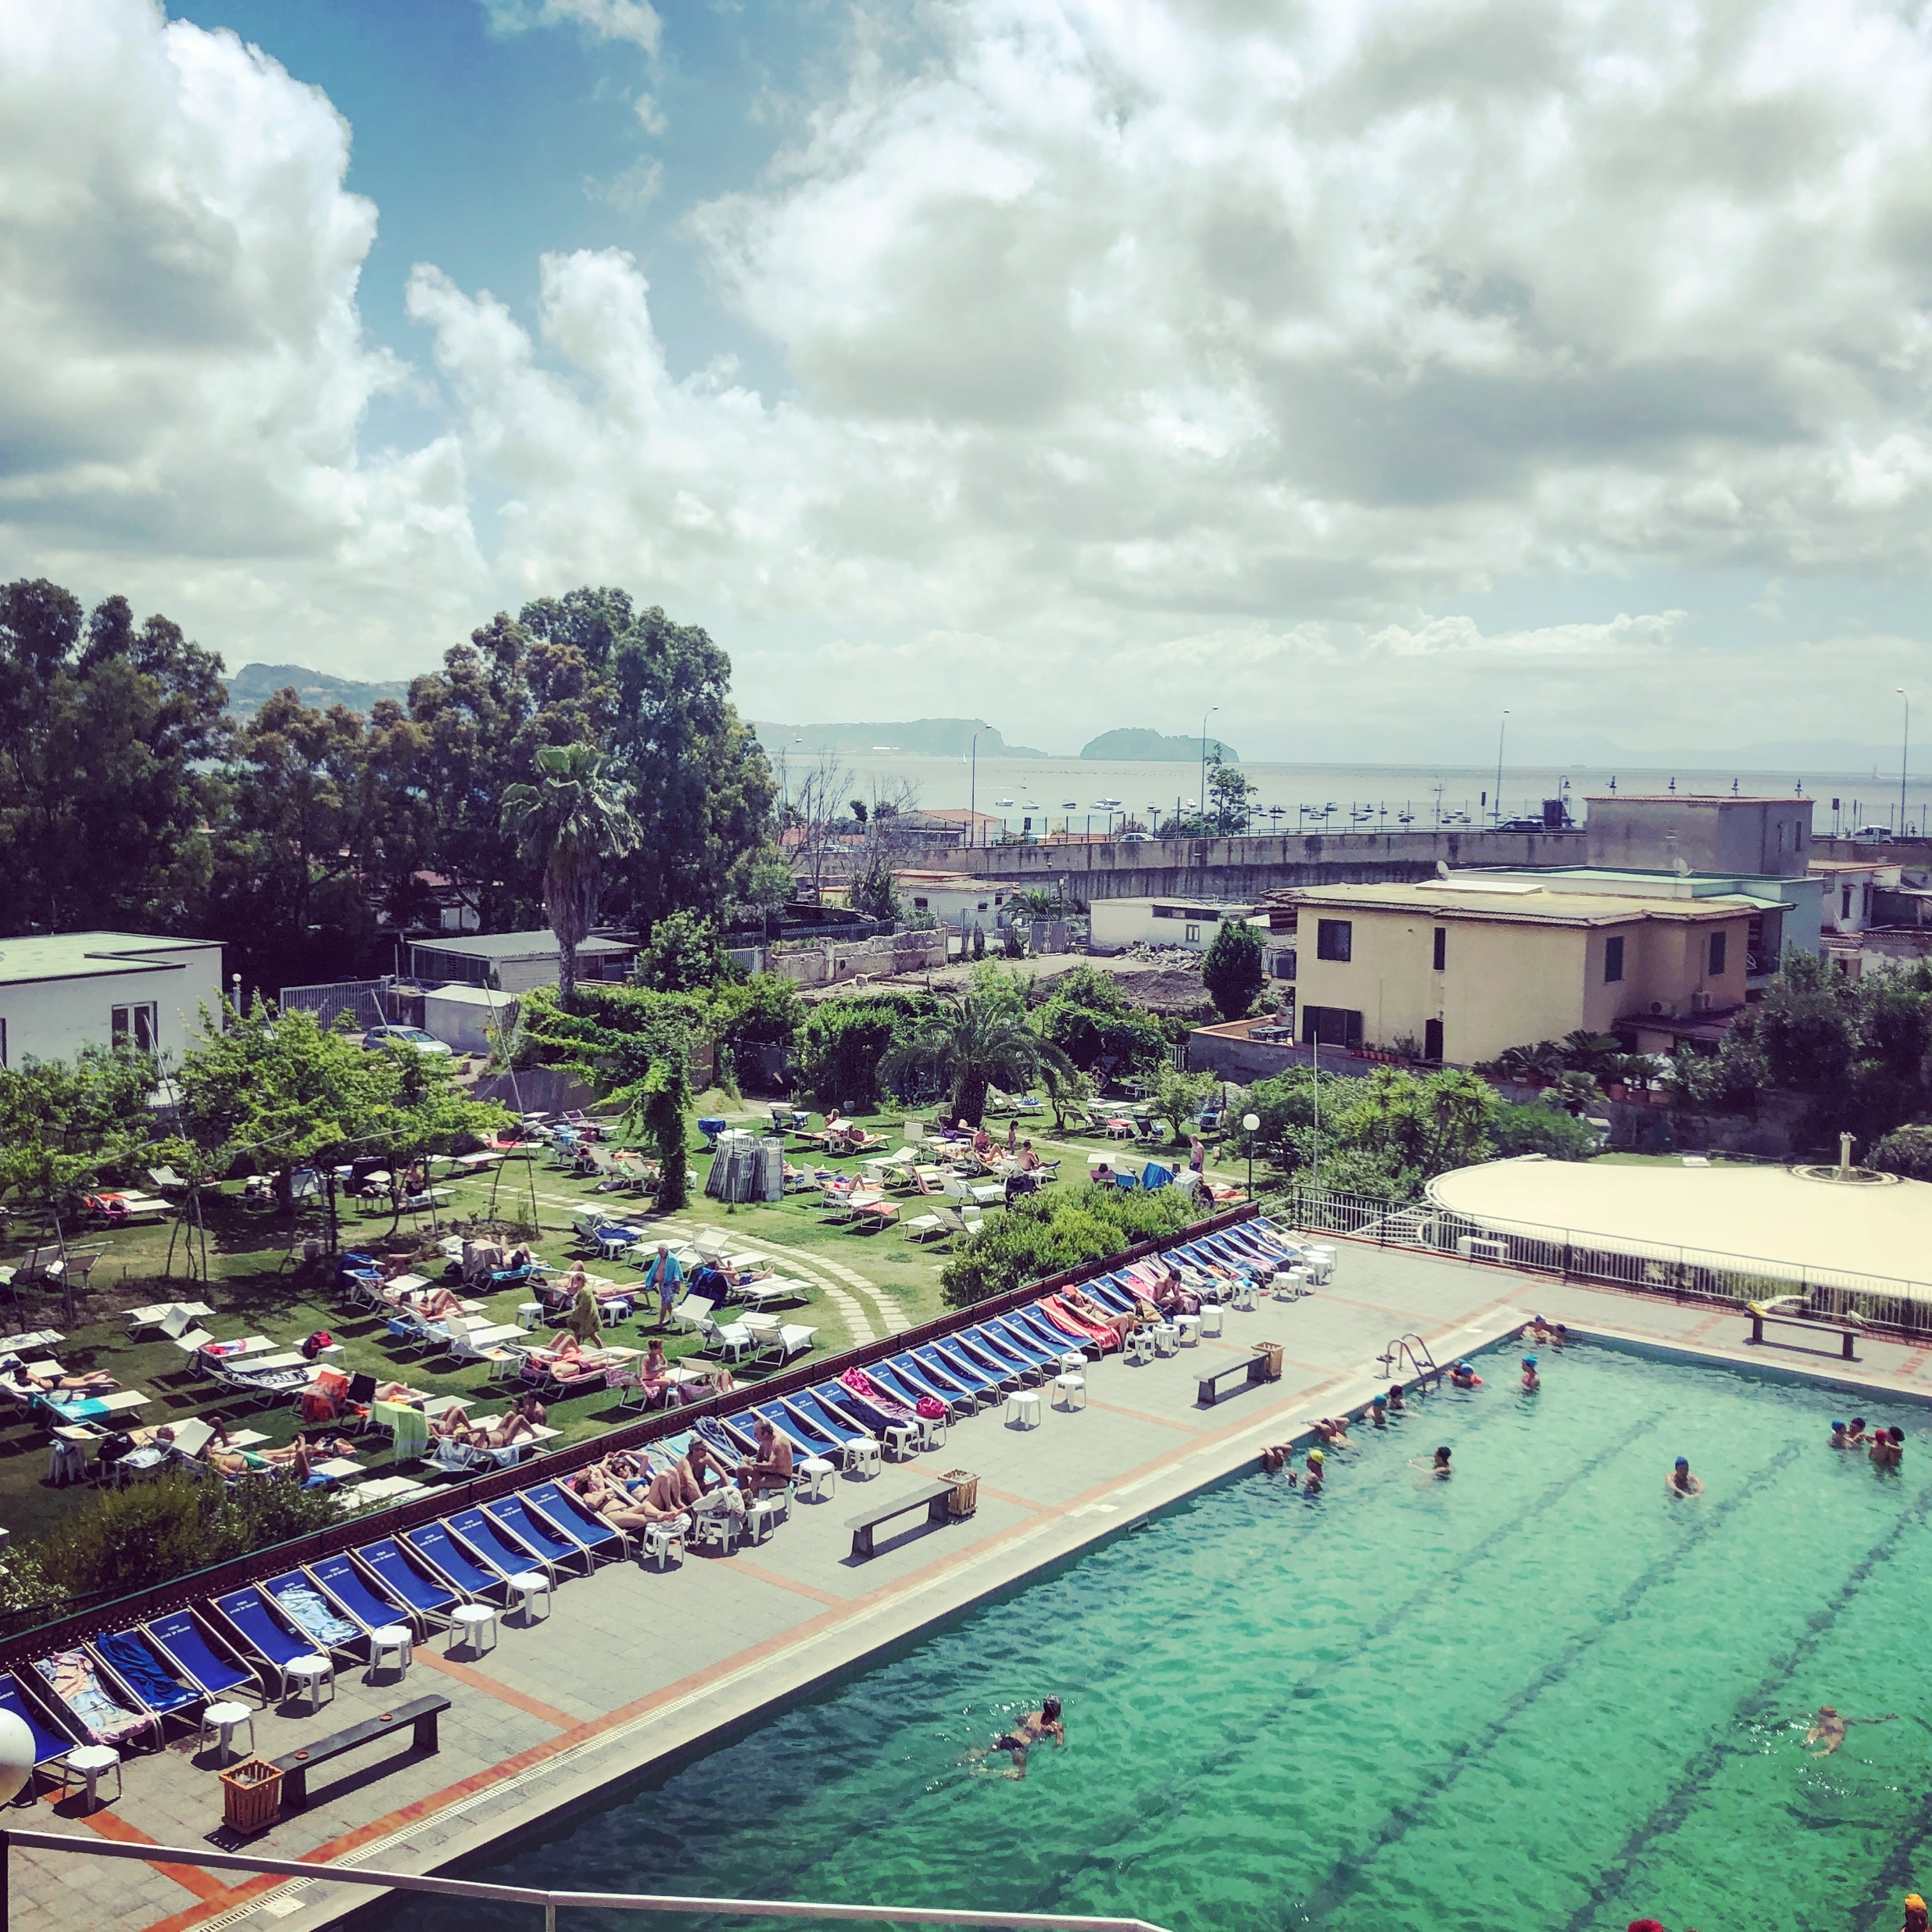
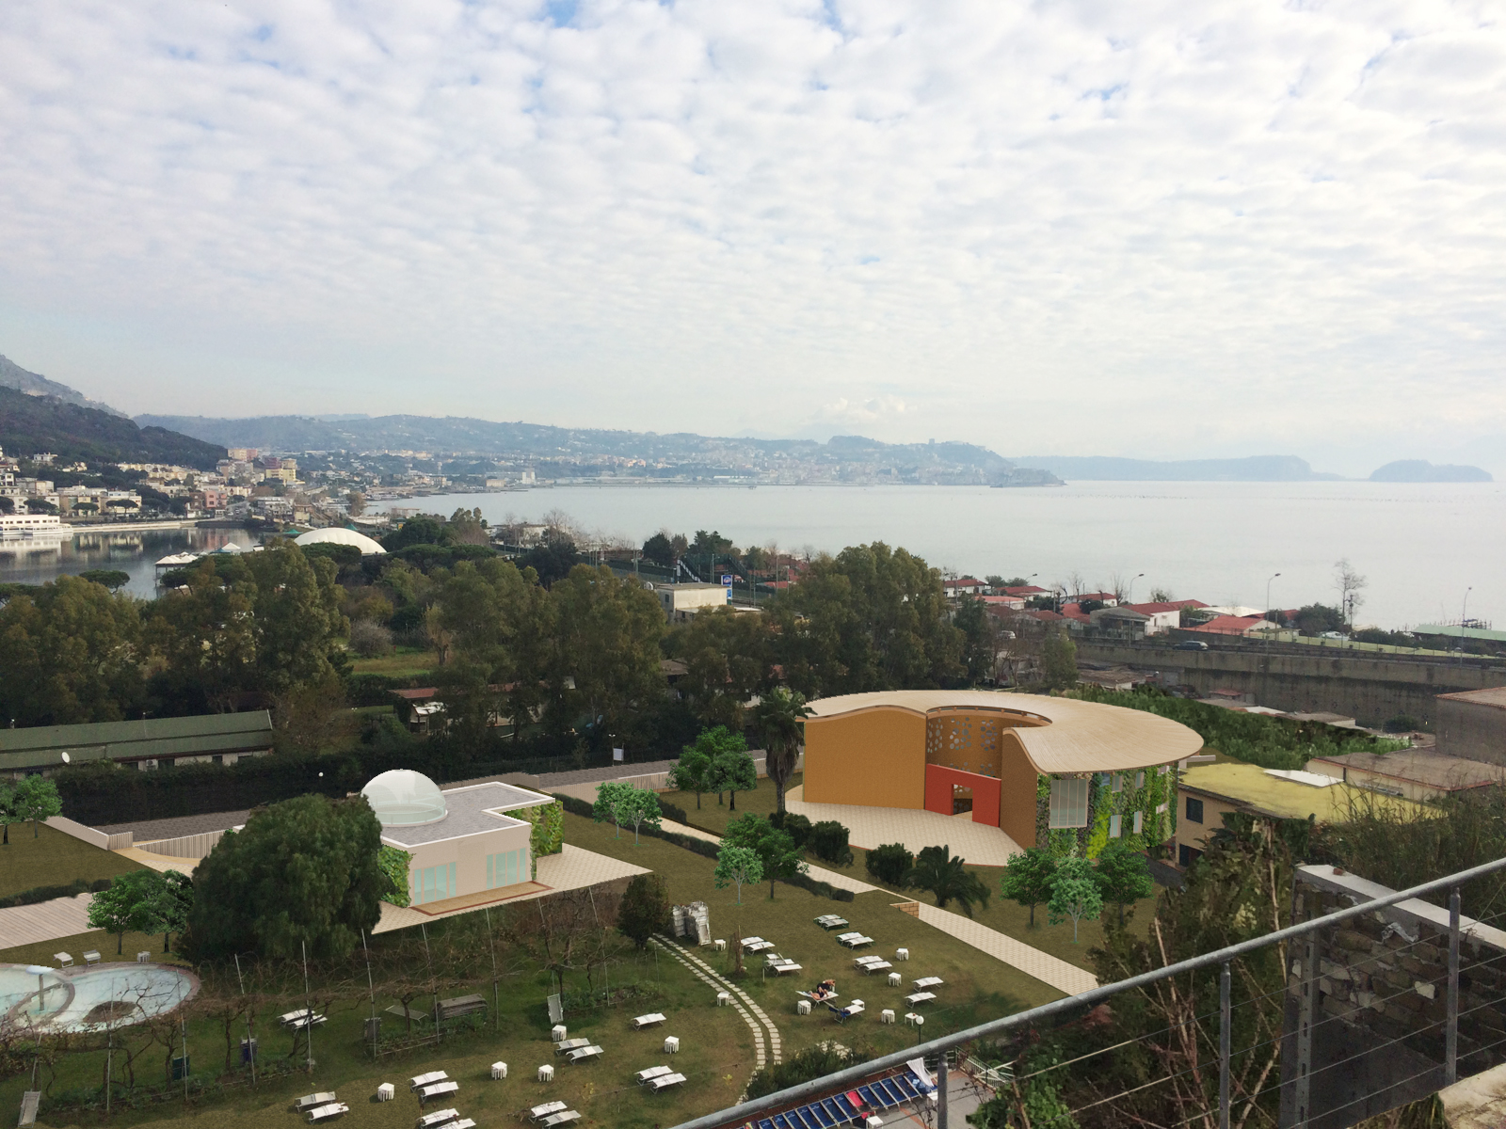
Fisiokine and thermalism; a case report
Notes:
Aggiungere icone o immagini

Slide 31
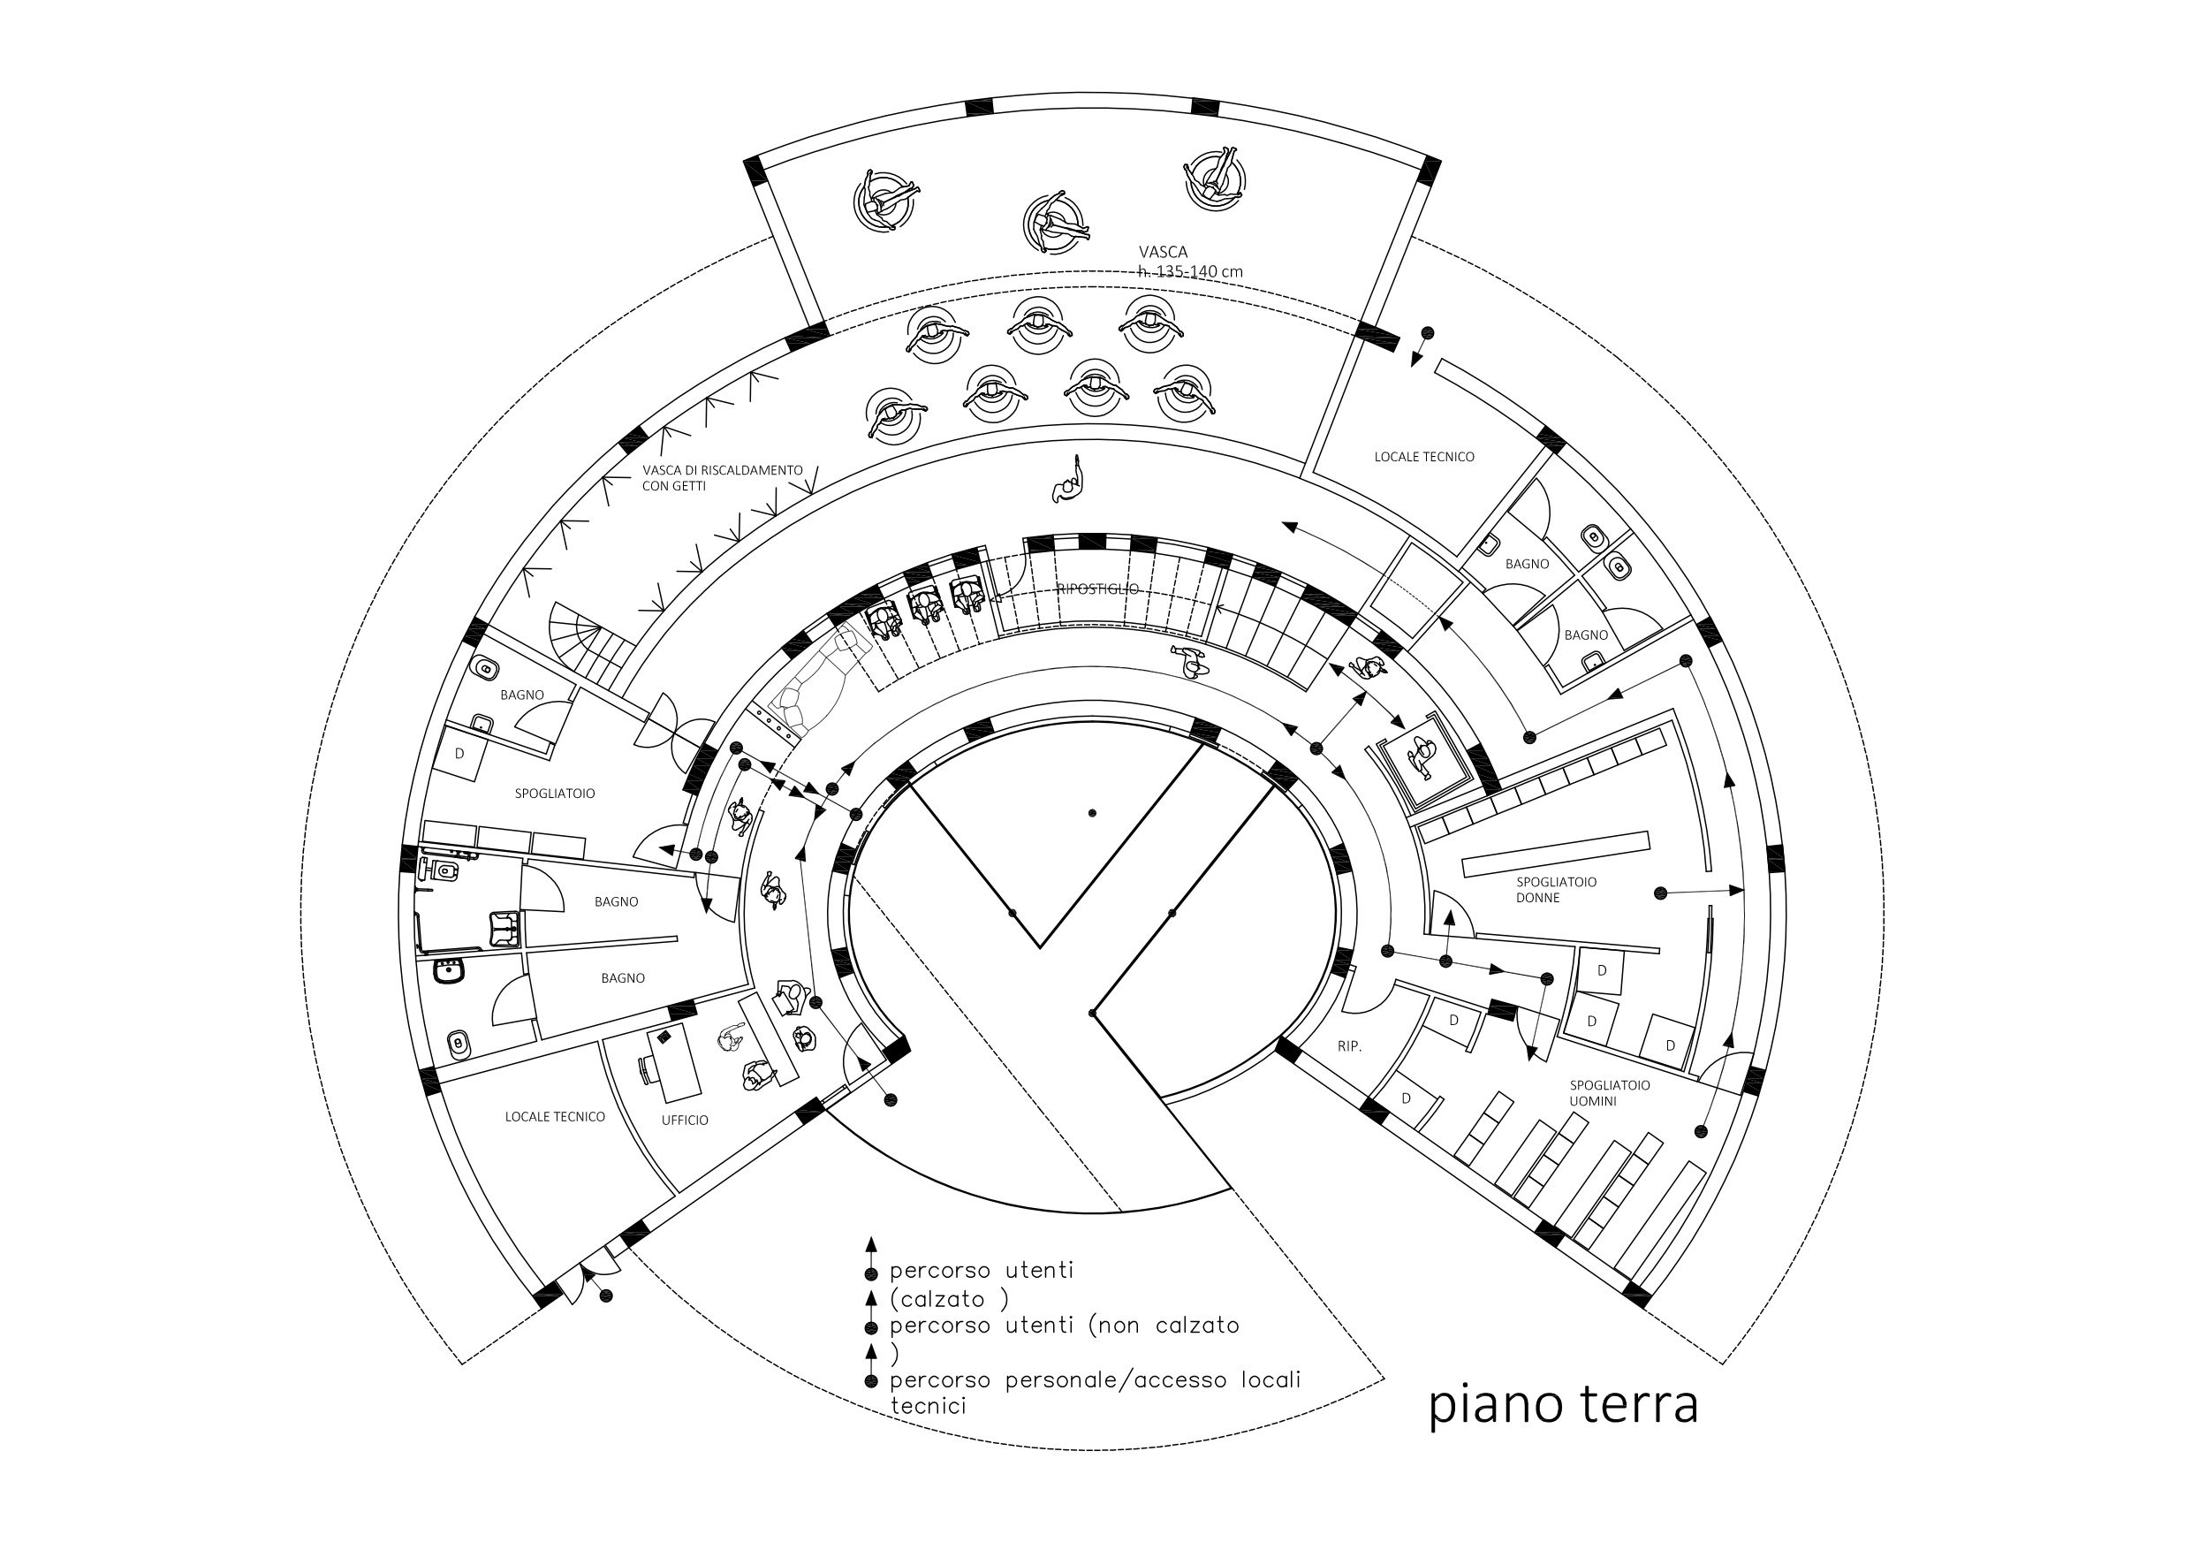
Fisiokine and thermalism; a case report
Notes:
Aggiungere icone o immagini

Slide 32
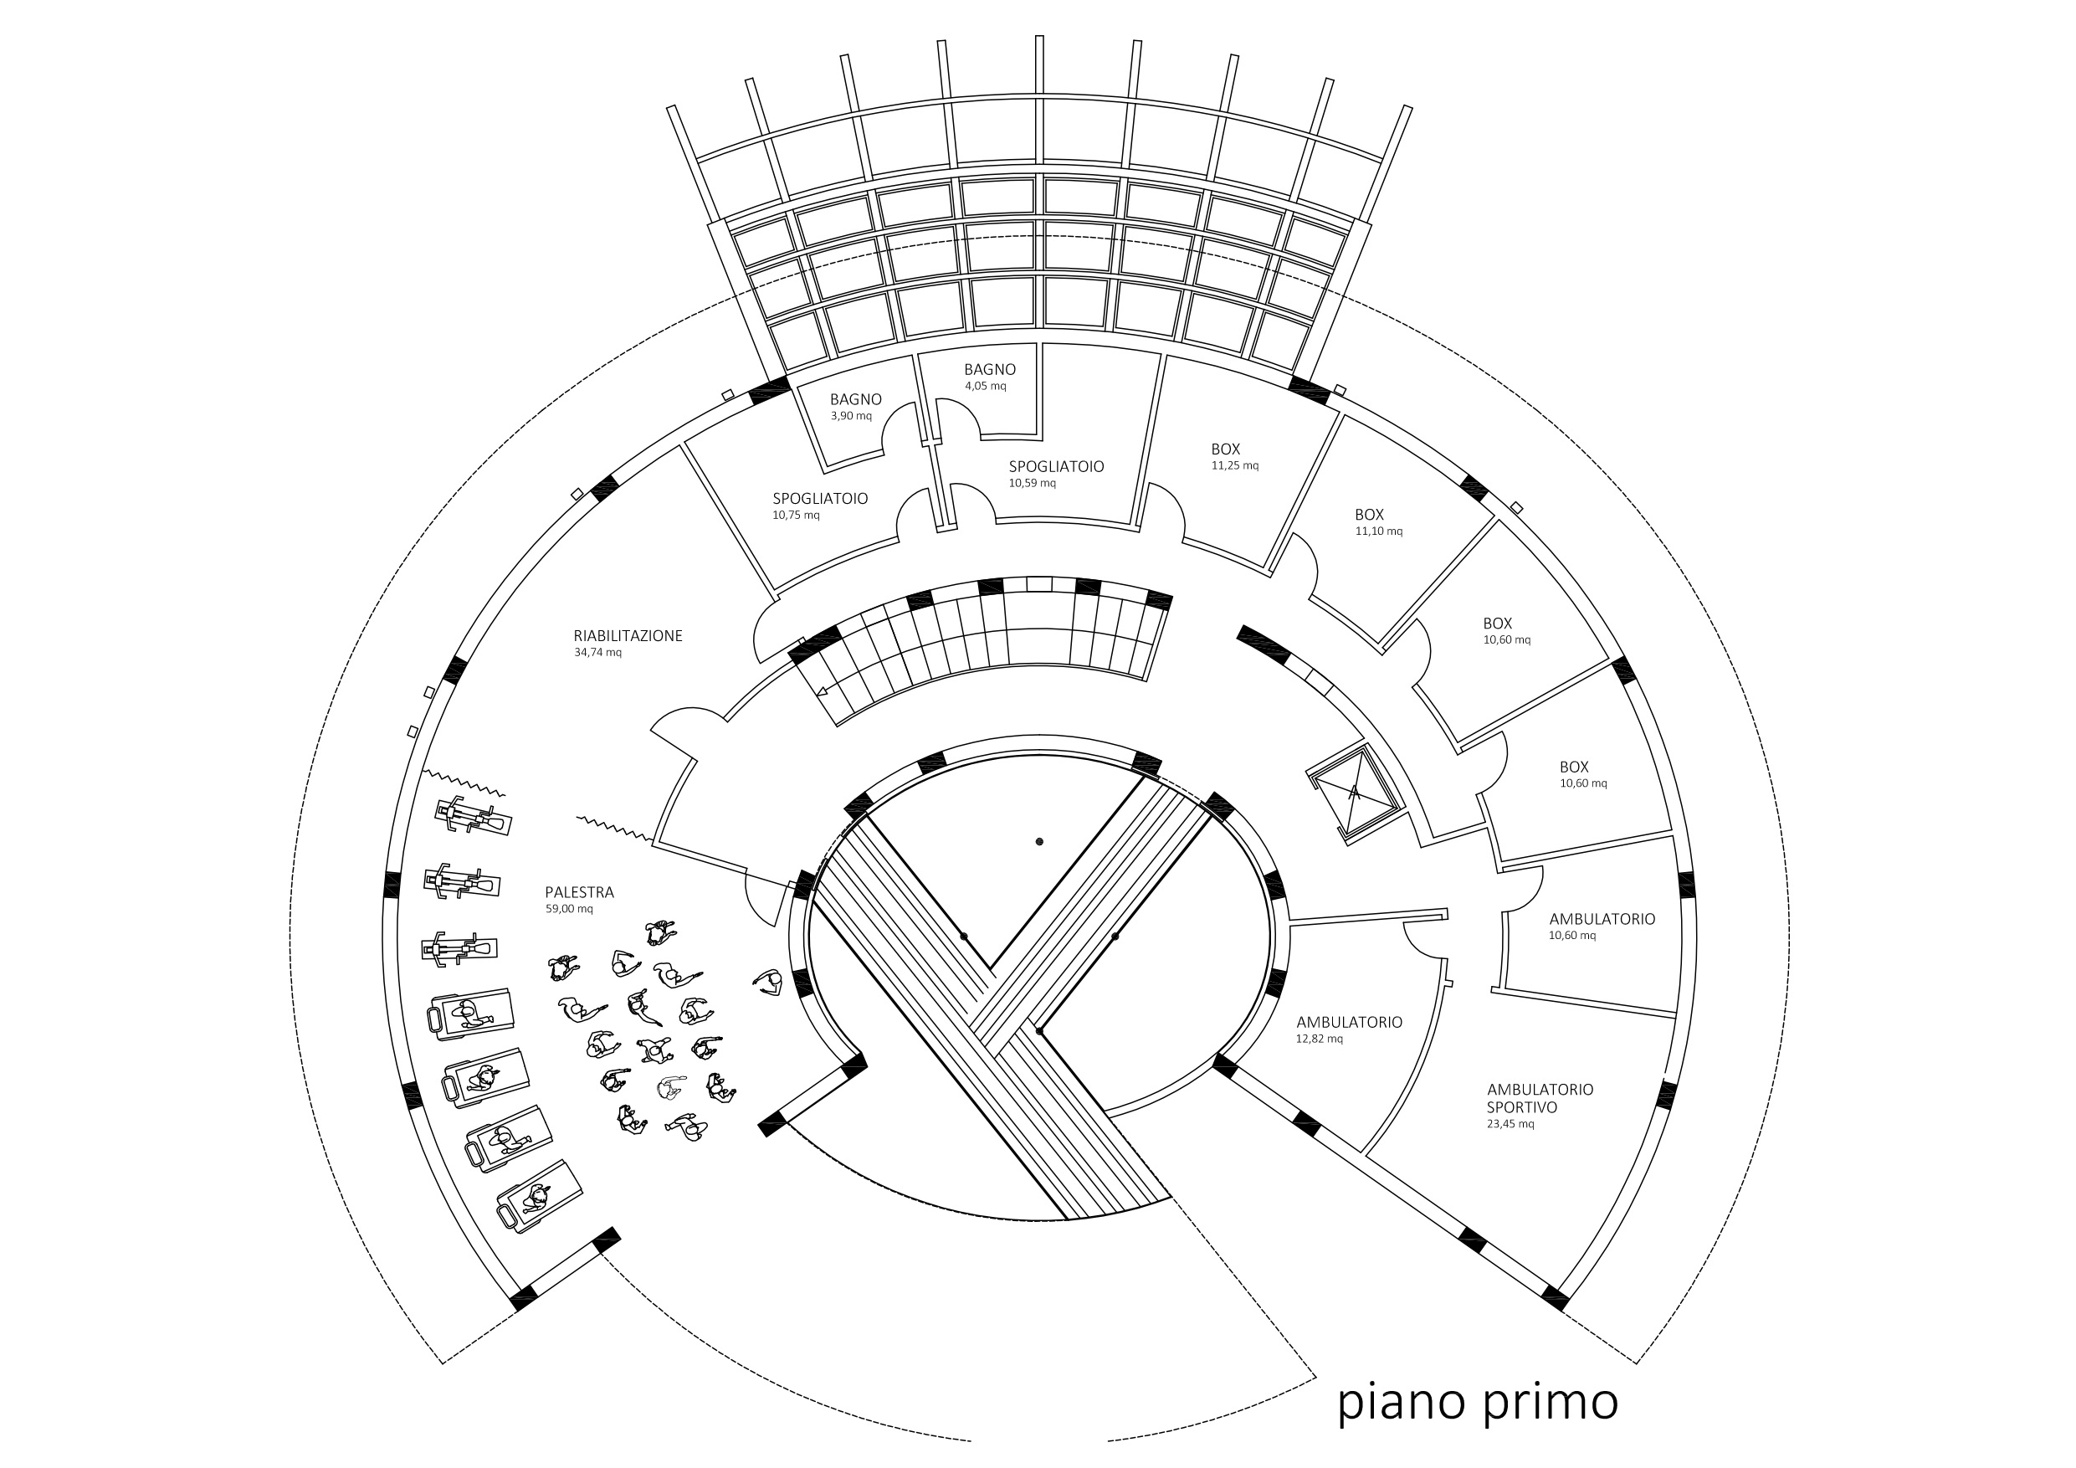
Fisiokine and thermalism; a case report
Notes:
Aggiungere icone o immagini

Slide 33
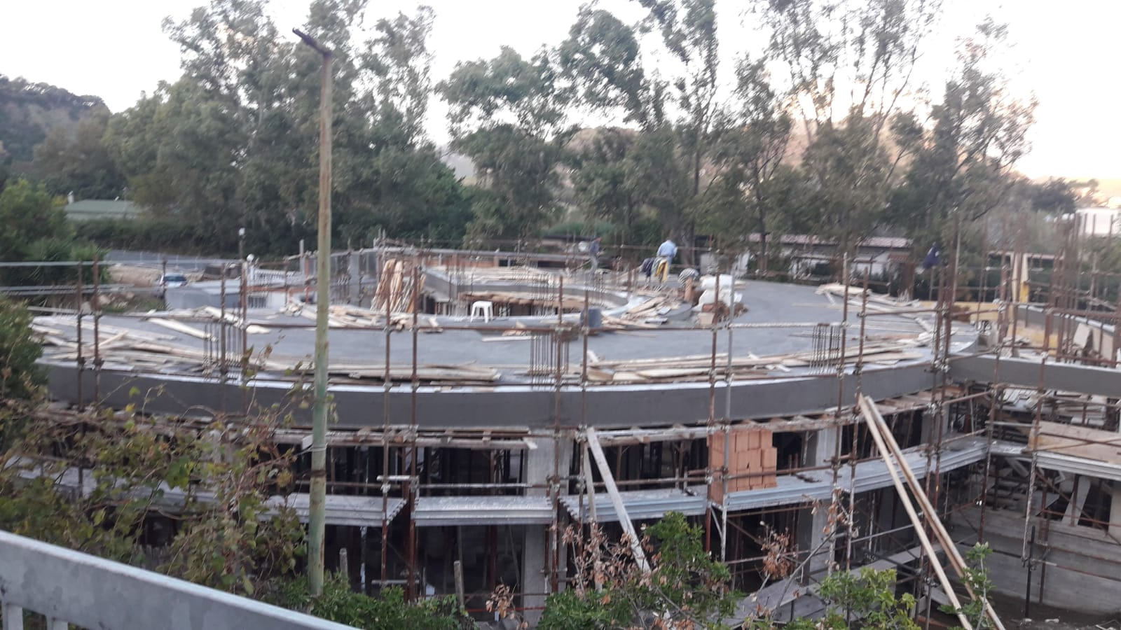
Fisiokine and thermalism; a case report
WHAT IS DONE
Planning and project
Market analysis
Financial support for EU or national subsidized loans
Notes:
Aggiungere icone o immagini

Slide 34
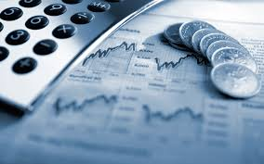

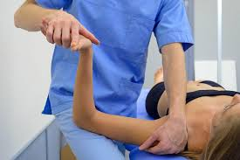
Fisiokine and thermalism; a case report
WHAT WILL BE DONE
Business plan
Financial support
Suppliers selection for
High tecnology
Start of training of physio and amministrative in end 2019
Opening beginning 2020
Notes:
Aggiungere icone o immagini

Slide 35
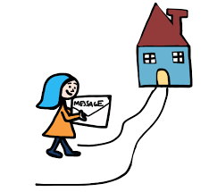
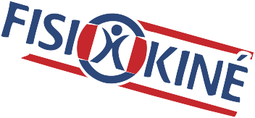

TAKE HOME MESSAGE
High profile and technology physioterapy can be a business opportunity for Thermal companies
Fisiokine can be a partner to develop this business due to his great experience
Notes:
Aggiungere icone o immagini

Slide 36
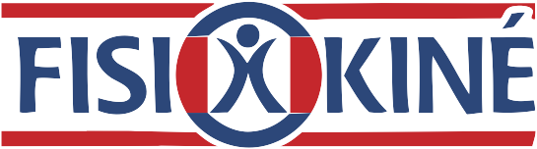


info@ﬁsiokine.com
+39 347 0749547
+39 347 4436303
www.fisiokine.com

