Slide 1



Balneology in the World
at the Time of COVID-19
Health, Economy, Sustainability
Prof Marc Cohen
MBBS(Hons), PhD_{(TCM)}, PhD_{(Elec Eng)}, B.MedSc(Hons)
Extreme Wellness Institute
Bathe the World Foundation
www.drmarc.co
www.extremewellness.co

Slide 2
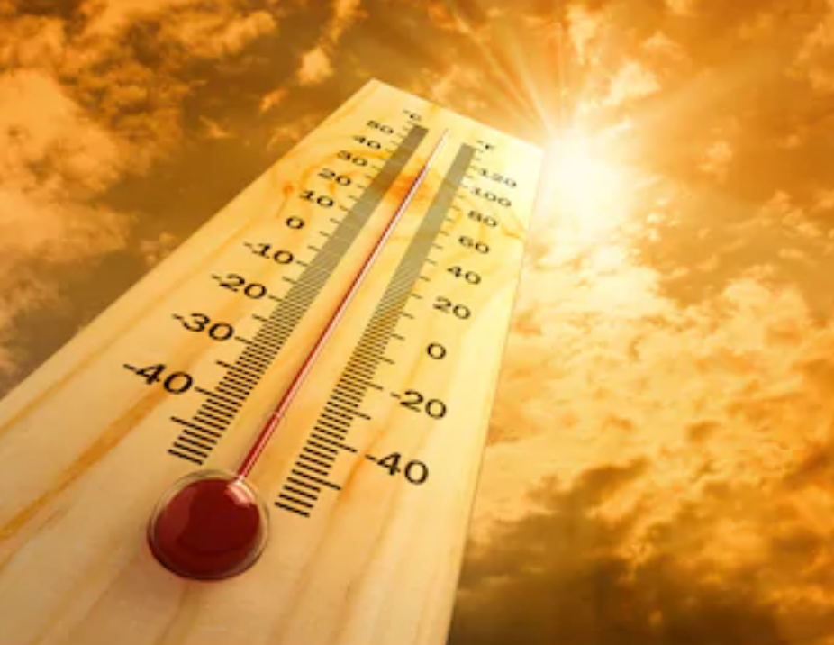
Heat is Effective Against Respiratory Viruses
Hydrothermal therapies such as saunas, steam rooms, hot baths, balneotherapy, pelotherapy etc are backed by:
Evolutionary evidence
Historical evidence
Epidemiological evidence
Anecdotal evidence
Clinical evidence
Randomized controlled-trials
Cohen M. Turning up the heat on COVID-19: heat as a therapeutic intervention F1000Research 2020, 9:292
©DrMarc.co

Slide 3
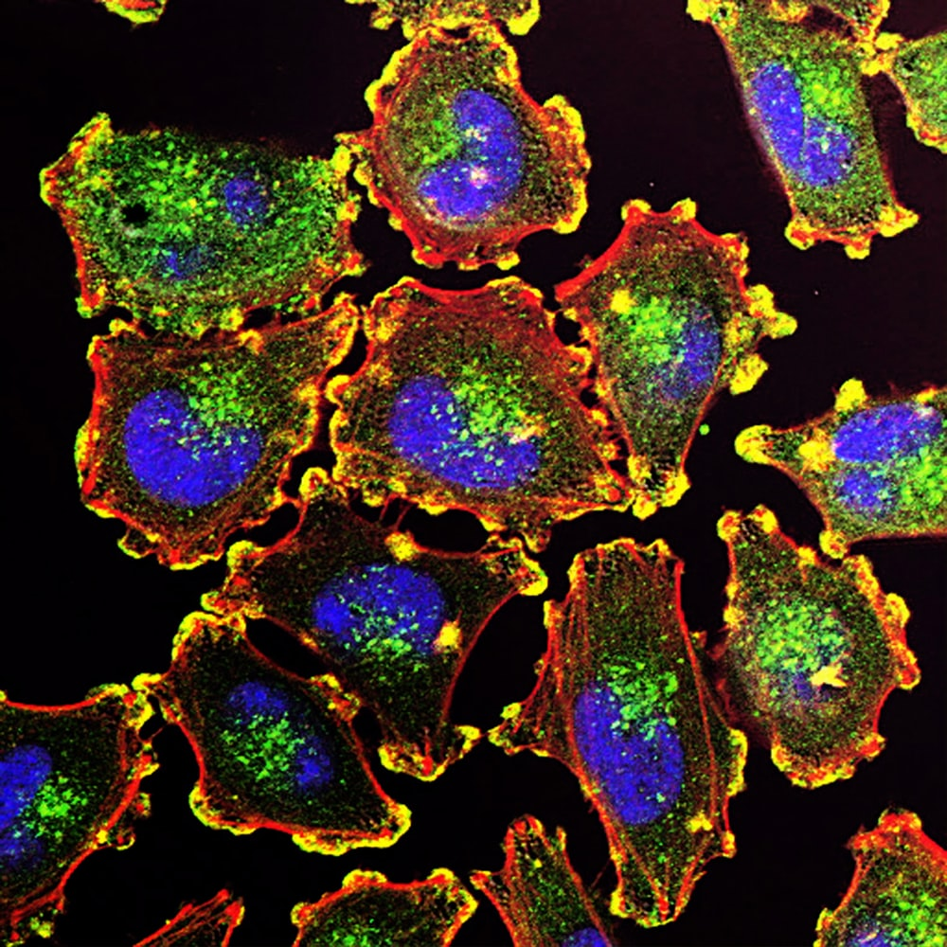
Cellular Effects of Heat Stress
Acute Heat Stress
↑ airway temperature and directly inhibits pathogens
↑ immune cell differentiation and activation
↑ the TNF-alpha response of monocytes
↑ IL-2 induced activity of Natural Killer cells
↑ x10 interferon-γ release from T cells
Regular heat-stress
Reduces adrenaline and cortisol
Increases the cytotoxicity of NK cells
Enhances the proliferative response of B cells
Releases Heat Shock Proteins, which protect immune cells and proteins from heat/cold-induced damage
Reduces blood pressure and builds vascular resilience
©DrMarc.co

Slide 4
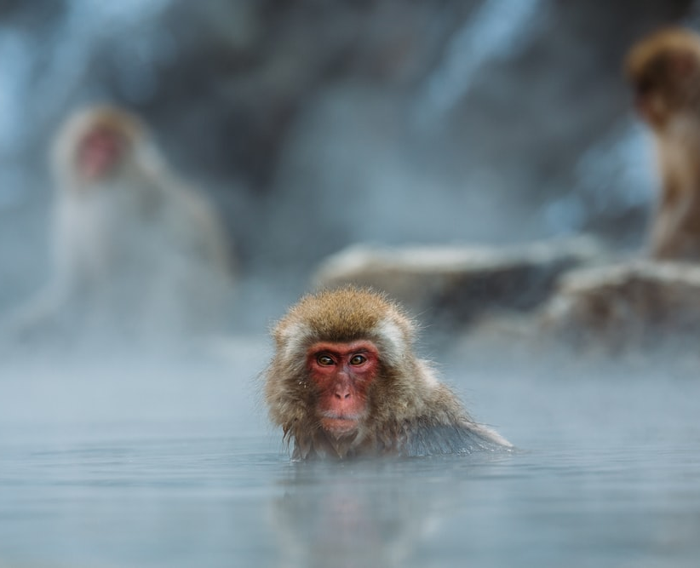
Physiological Effects of Heat-Stress
↑ body temp (simulates fever)
↑ cardiac output and lowers peripheral resistance
↑ blood pH
↑ anti-inflammatory responses
↑ immune activity
↑ detoxification from organs and skin
↑ vascular function
↑ physiological resilience (hormesis)
↑ effects with hydration
↑ effect with cold and essential oils
©DrMarc.co

Slide 5
Psychological Benefits of Heat-Stress
Focus on fun and positive action
‘Forced-mindfulness’
Social activity that enhances social connection
Enhanced relaxation and sleep
Activates the placebo response, the power of positive thinking and ‘remembered wellness’
©DrMarc.co

Slide 6
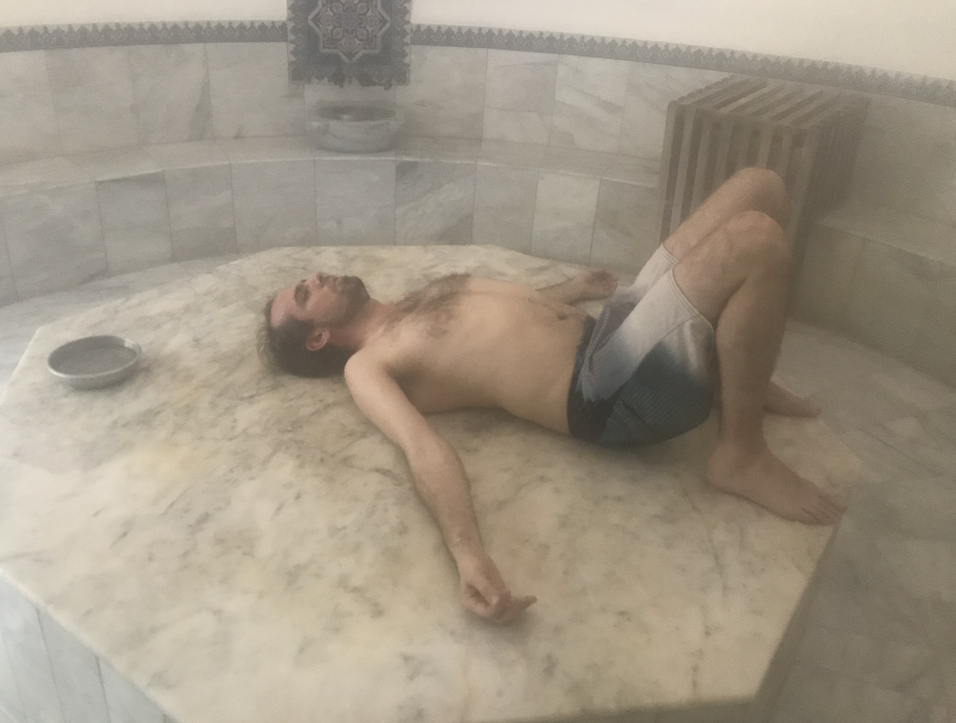
Spa Environments Inhibit Respiratory Viruses
Warm humid environments support the immune system’s first line of defense [26].
Humans can tolerate temperatures that destroy coronaviruses.
Air quality is enhanced at hot springs and thermal water inhalation enhances systemic immune responses [23].
Balneotherapy and aquatic therapy improves respiratory function and helps prevent and treat respiratory diseases [27, 28].

Slide 7
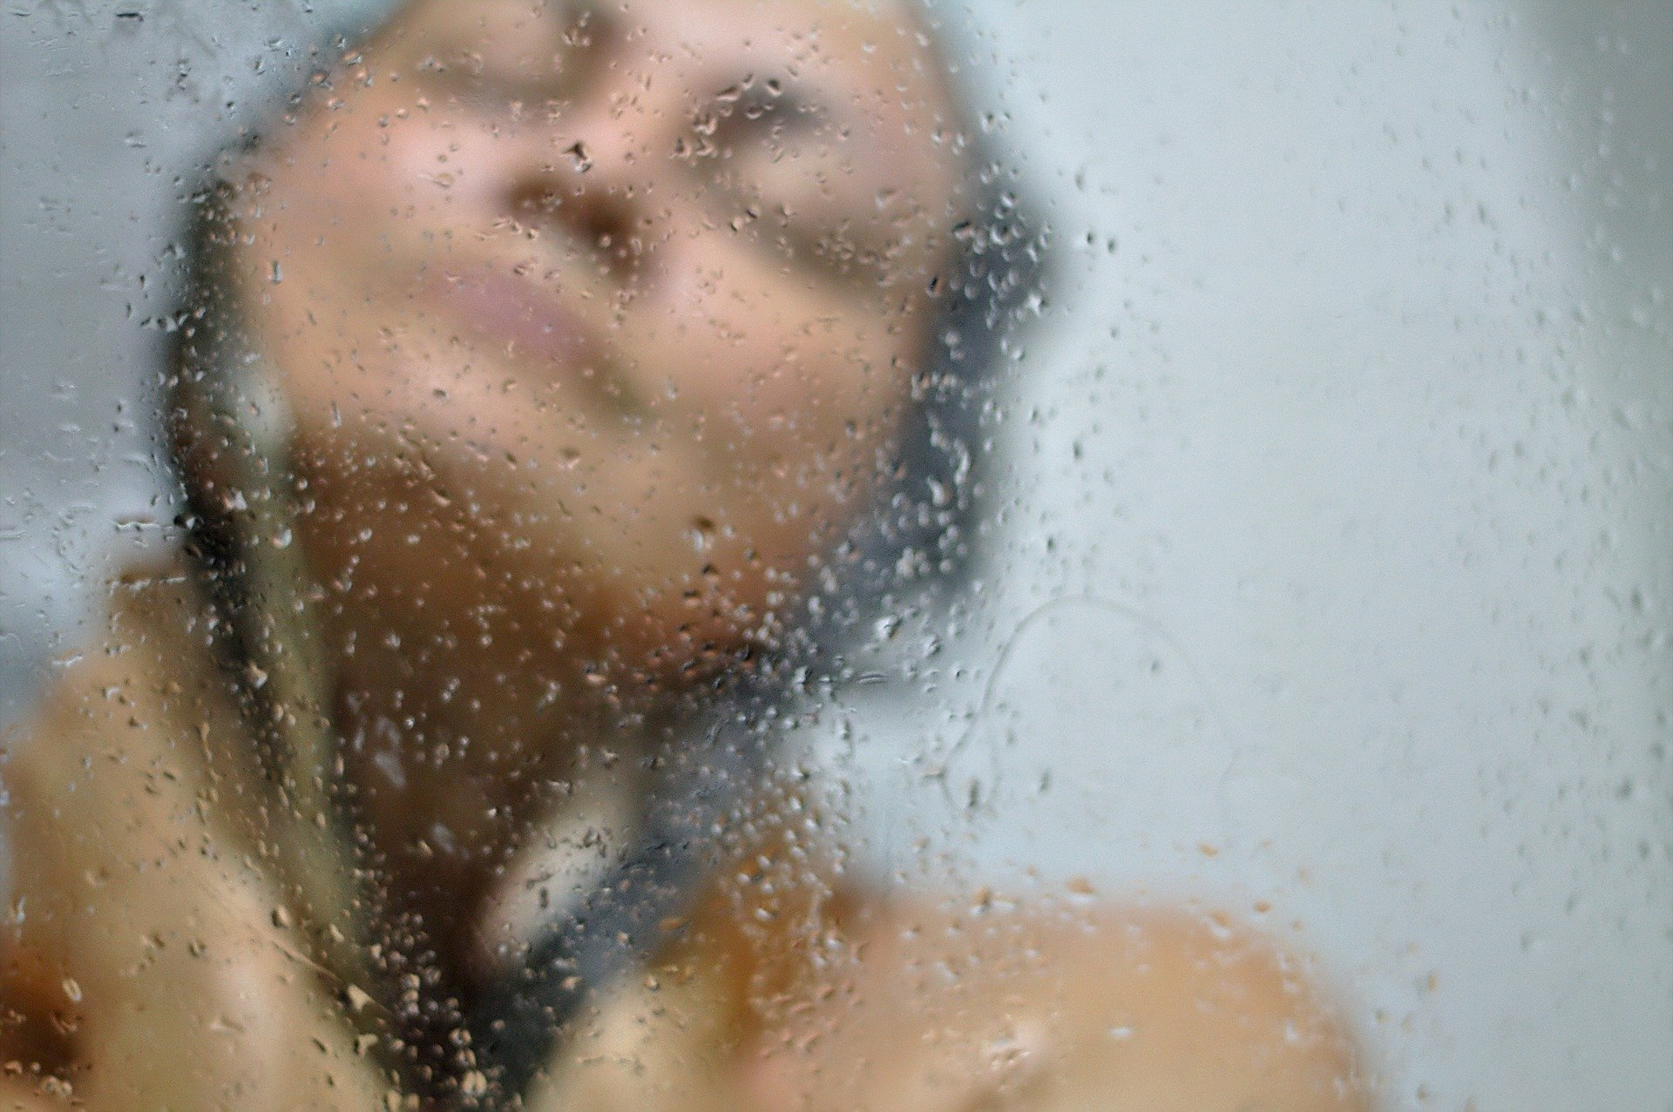
Dosing for Forced Mindfulness
• Exposure depends on by time, temp and humidity
• Tolerance varies with experience, time and mindset
• Benefits arise from ‘forced mindfulness’
• Regaining balance is just as important as endurance
• A standard protocol is: rinse, hot, cold, rest, repeat

Slide 8
Reassurance and Education
Cleaning protocols and hygiene
Infection control and monitoring
Measures to protect vulnerable people
Therapeutic protocols
Safety Measures
©DrMarc.co

Slide 9

Common Sense Safety
Drink: Stay hydrated with good quality water.
Take care: Heat sources can burn or scald and sudden changes in posture can lead to dizziness or fainting;
Know your limits: Heat tolerance varies between individuals and within the same individual at different times. Use your comfort level as a guide to exposure and don’t go beyond the point of being 'comfortably uncomfortable’.
Be aware: Tune into your senses, monitor your tolerance and enjoy heat-induced ‘forced mindfulness’. Avoid extremes of temperature when under the influence of alcohol or drugs that impair your judgement;
Rest: Alternate exposure to hot or cold with relaxation and re-balancing. Spend at least as much time resting and coming back into physiological balance as you spend in extremes of temperature.
©DrMarc.co

Slide 10
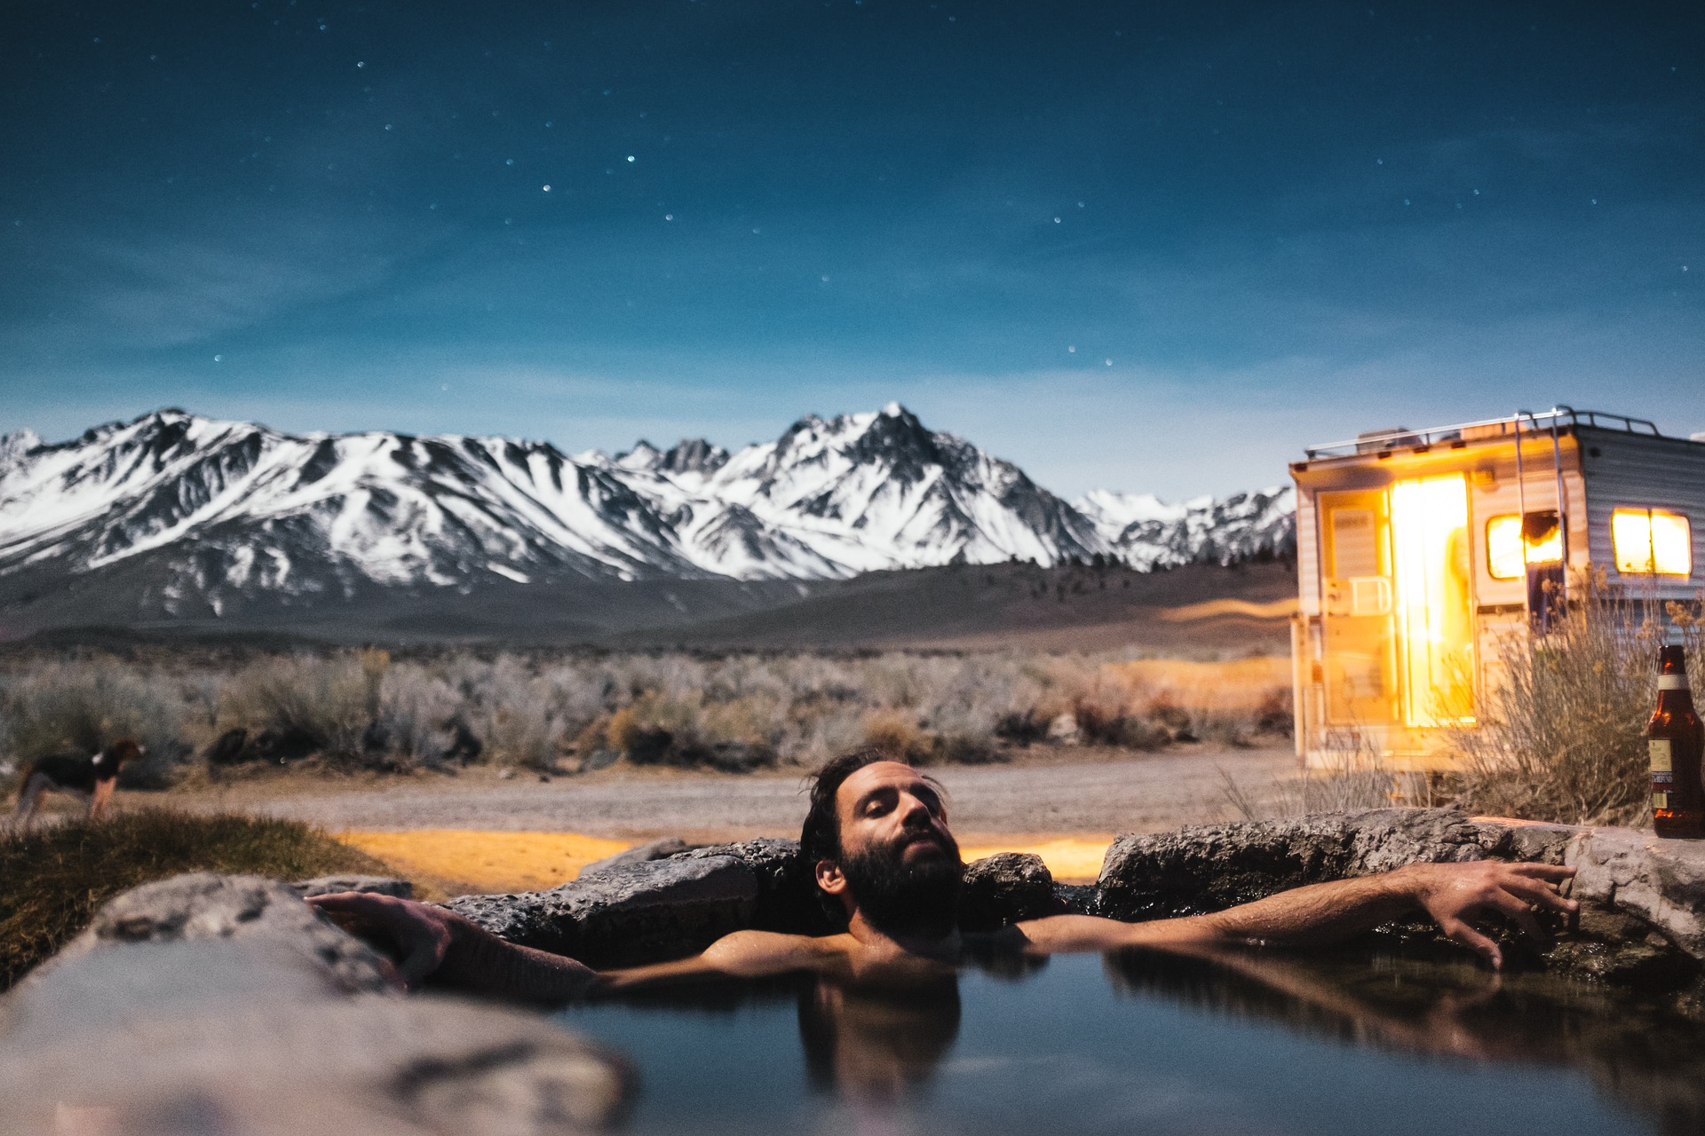
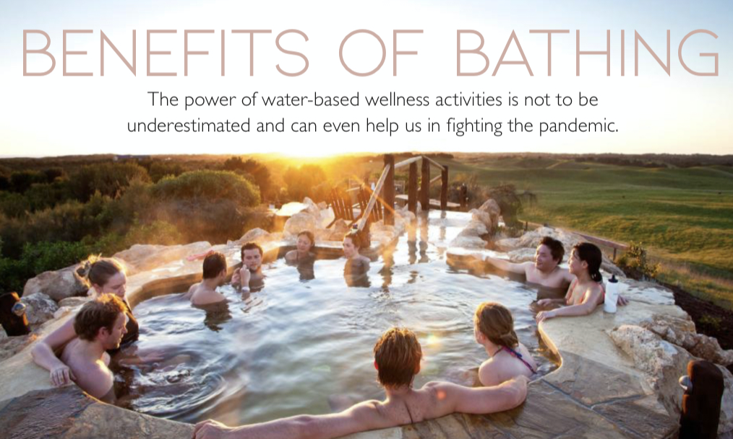
Benefits of Balneology & Spa Treatments
They are cheap, convenient and widely accessible and draw from traditional practices and modern science
Need to consider contraindications, adverse effects and infection control
Integrate natural medicine, conventional medicine and traditional wellness practices
Support the wellbeing of patients and medical staff and the community
Specific research is needed spa interventions to prevent and treat COVID-19.
©DrMarc.co

Slide 11








www.drmarc.co

