Slide 1
Pedro Cantista
Notes:
Before I start my lecture please aloud me to salute the Organizing and the Scientific Committees of this Congress and to express my gratitude for this invitation and hospitality.
Let me also send a special compliment to my dear friend Prof Elena Ilieva who is the responsible person for my presence. It is really a great honour to be present in your Congress

Slide 2
SUMMARY
Portugal general data
Evolution of the pandemic and Suspension of Thermal Care Activity
Reopening of thermal facilities (Guidance)
COVID -19 impact on Portuguese Economy and on Thermal Care Activity

Slide 3
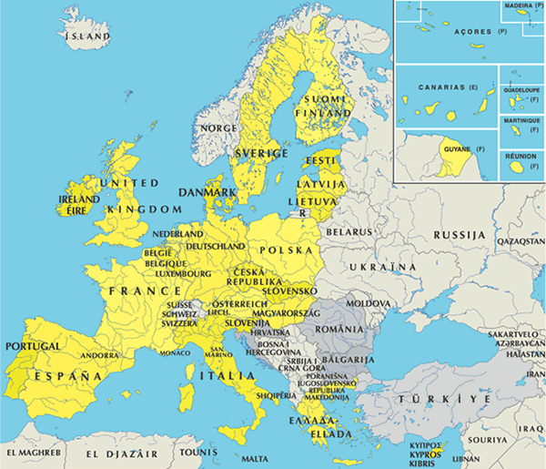
Notes:
Now: Let me tell you something about my country. Portugal is located on the very west extrem of Europe and besides the continental territory has also 2 groups of Atlantic Islands Azores and Madeira

Slide 4
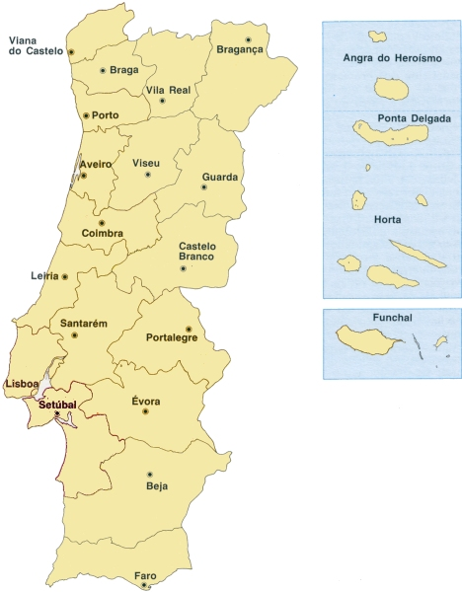
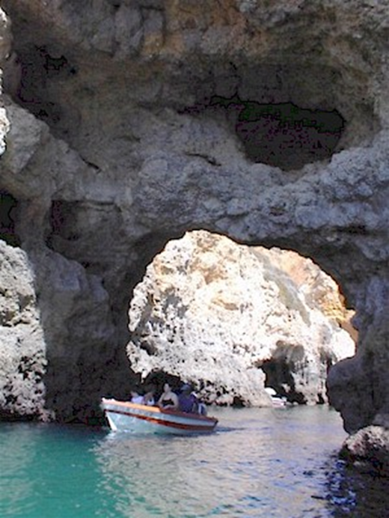
Area: 92.389 km2
Population: 10.500.000 inhabitants ~
Capital: Lisbon
Official language: Portuguese
Life expectancy: 80 years ~
Infant mortality rate: < 3 / 1000

Slide 5
Coast Length in Portugal
943 km in Portugal (continental)
667 km in Azores,
250 km in Madeira
1.860 Km total
Notes:
With a very long coast

Slide 6
THERMAL SOURCES
Notes:
There are also volcanic formations

Slide 7
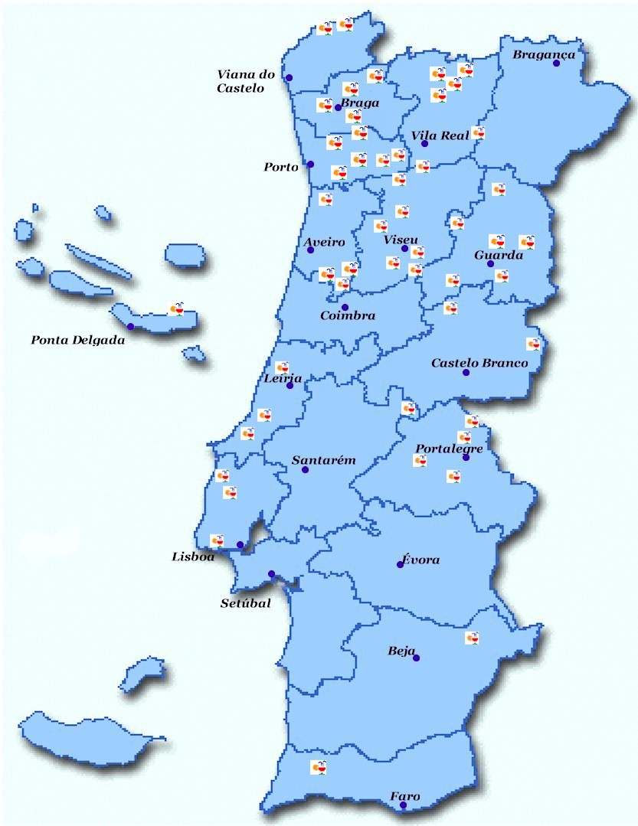

Slide 8
STRONG BALNEOLOGY TRADITION
First Thermal Hospital in the World (1498)
One of the first Balneology Books (1726)
Cultural heritage (Architecture)
Notes:
There are also volcanic formations

Slide 9
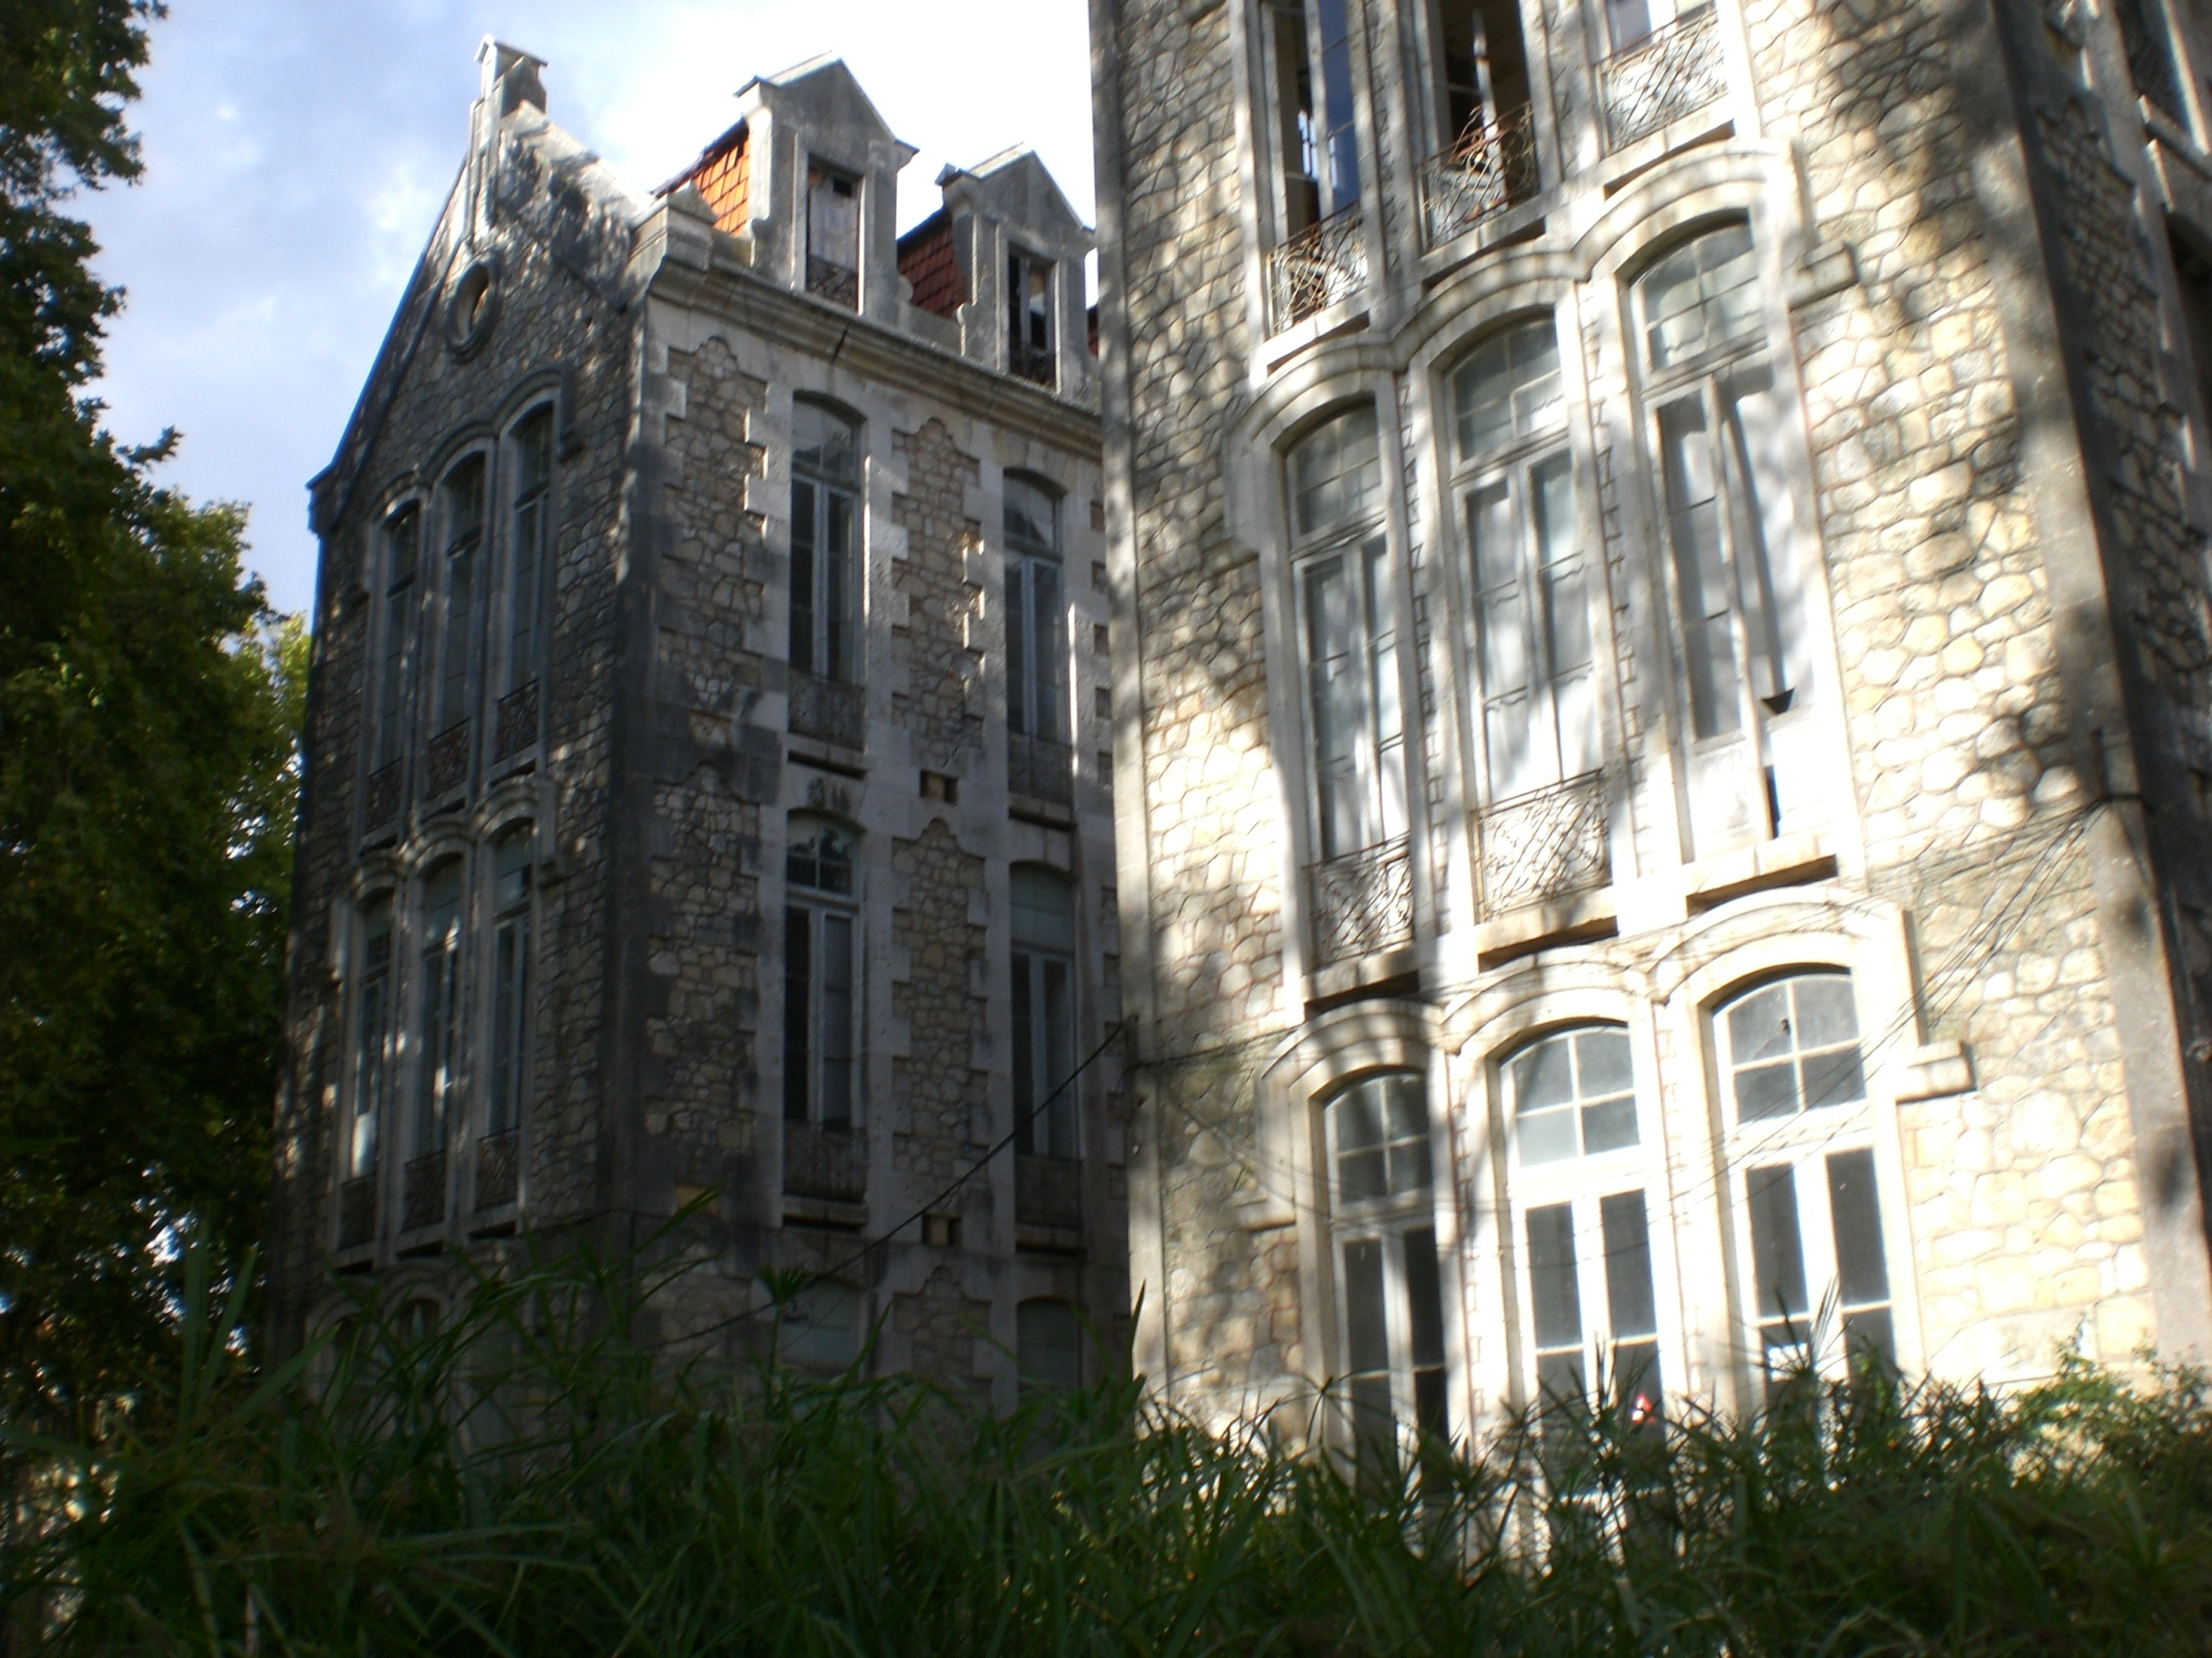

Slide 10
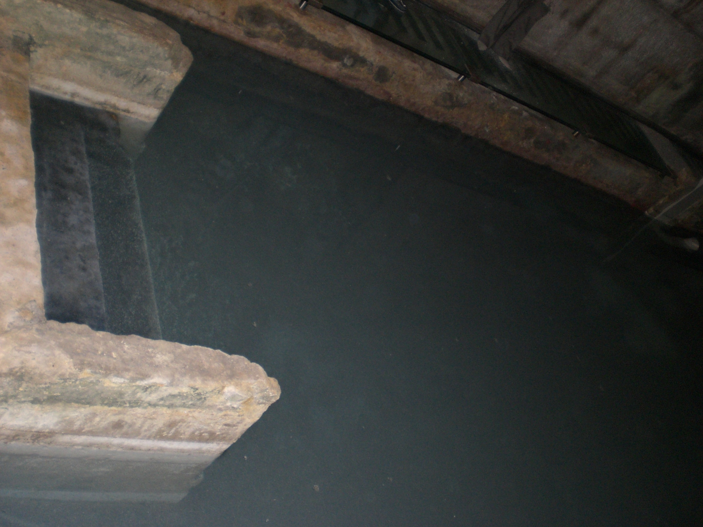

Slide 11
Francisco da Fonseca Henriques, 1726

Slide 12
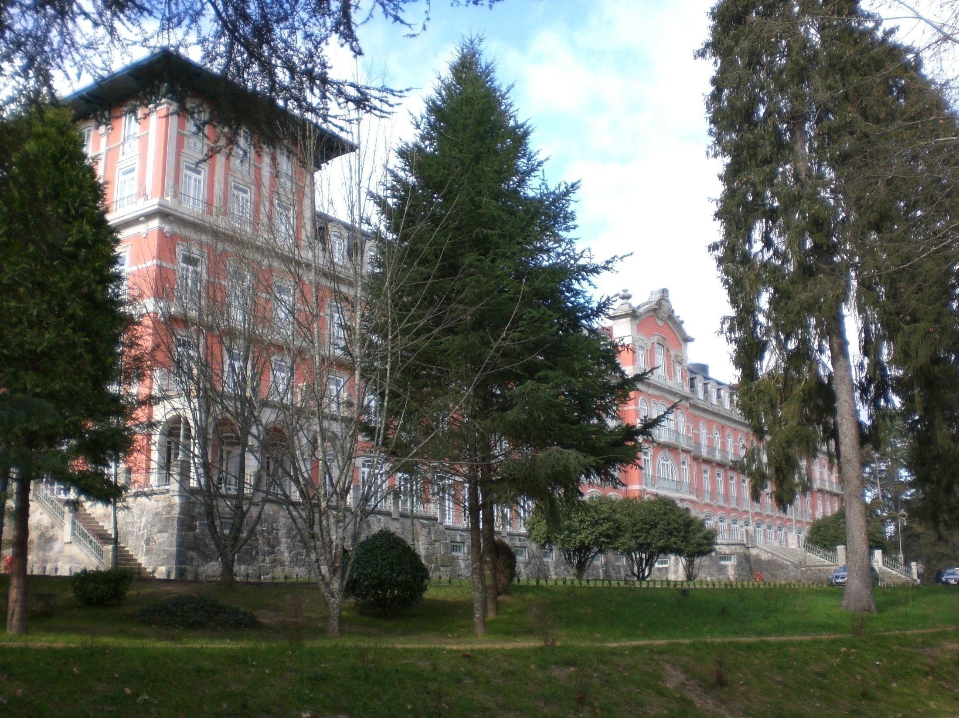

Slide 13
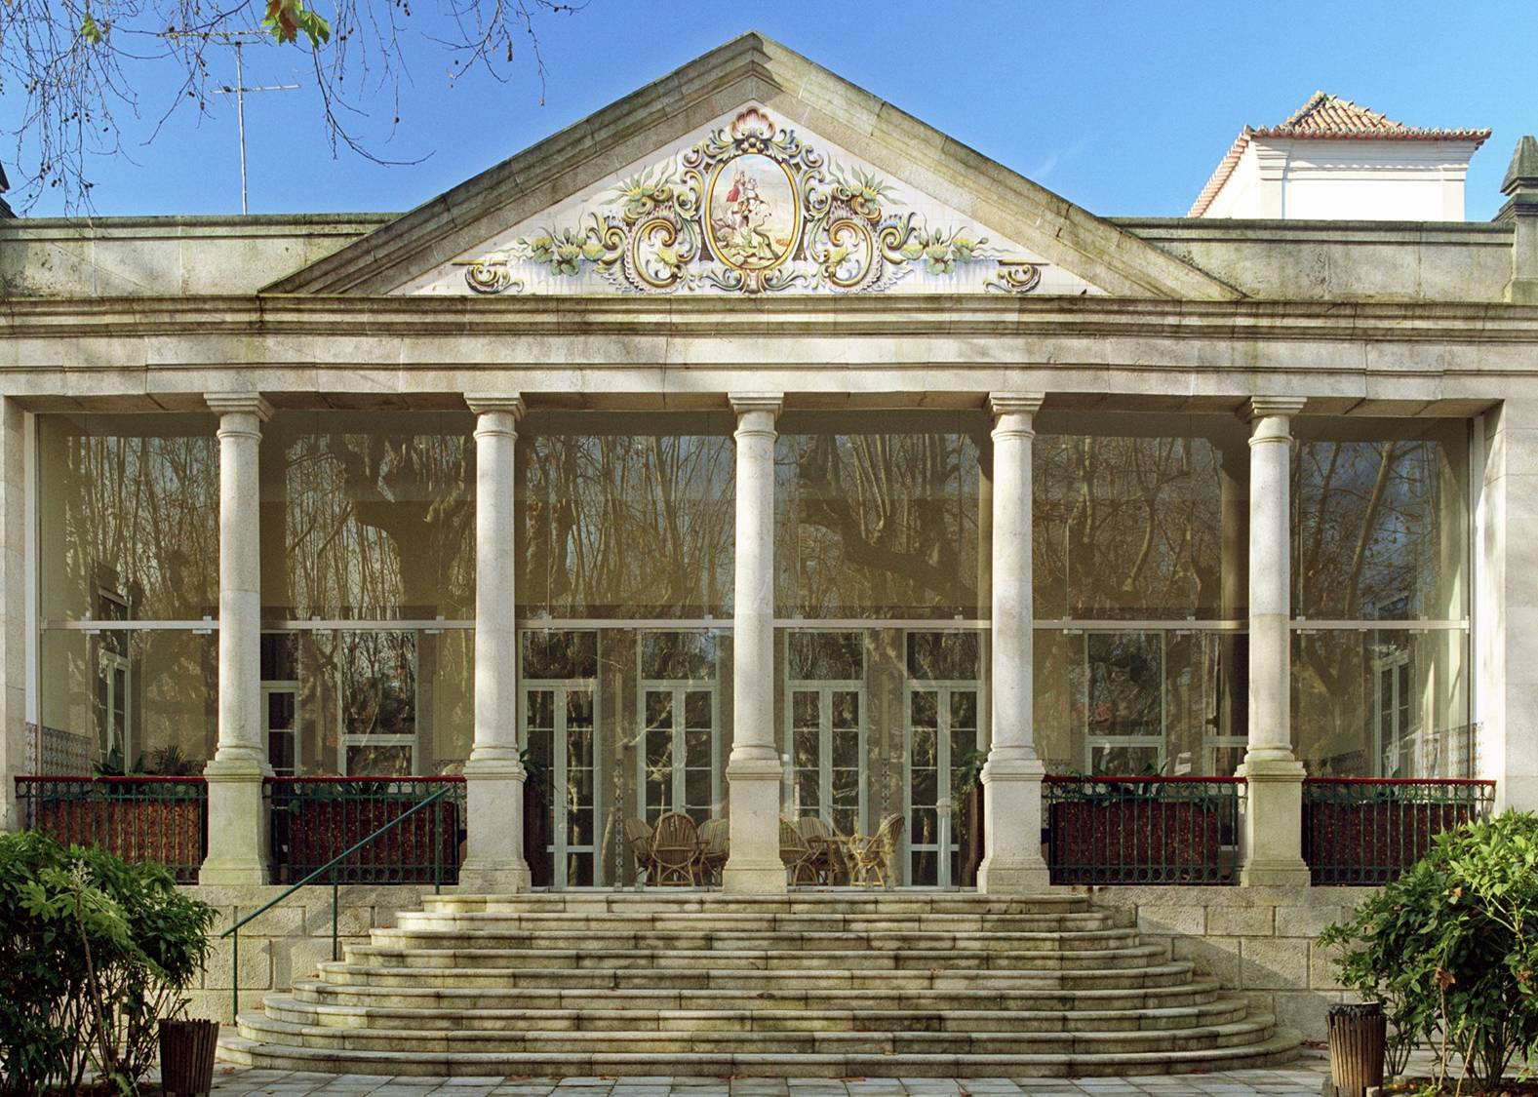

Slide 14
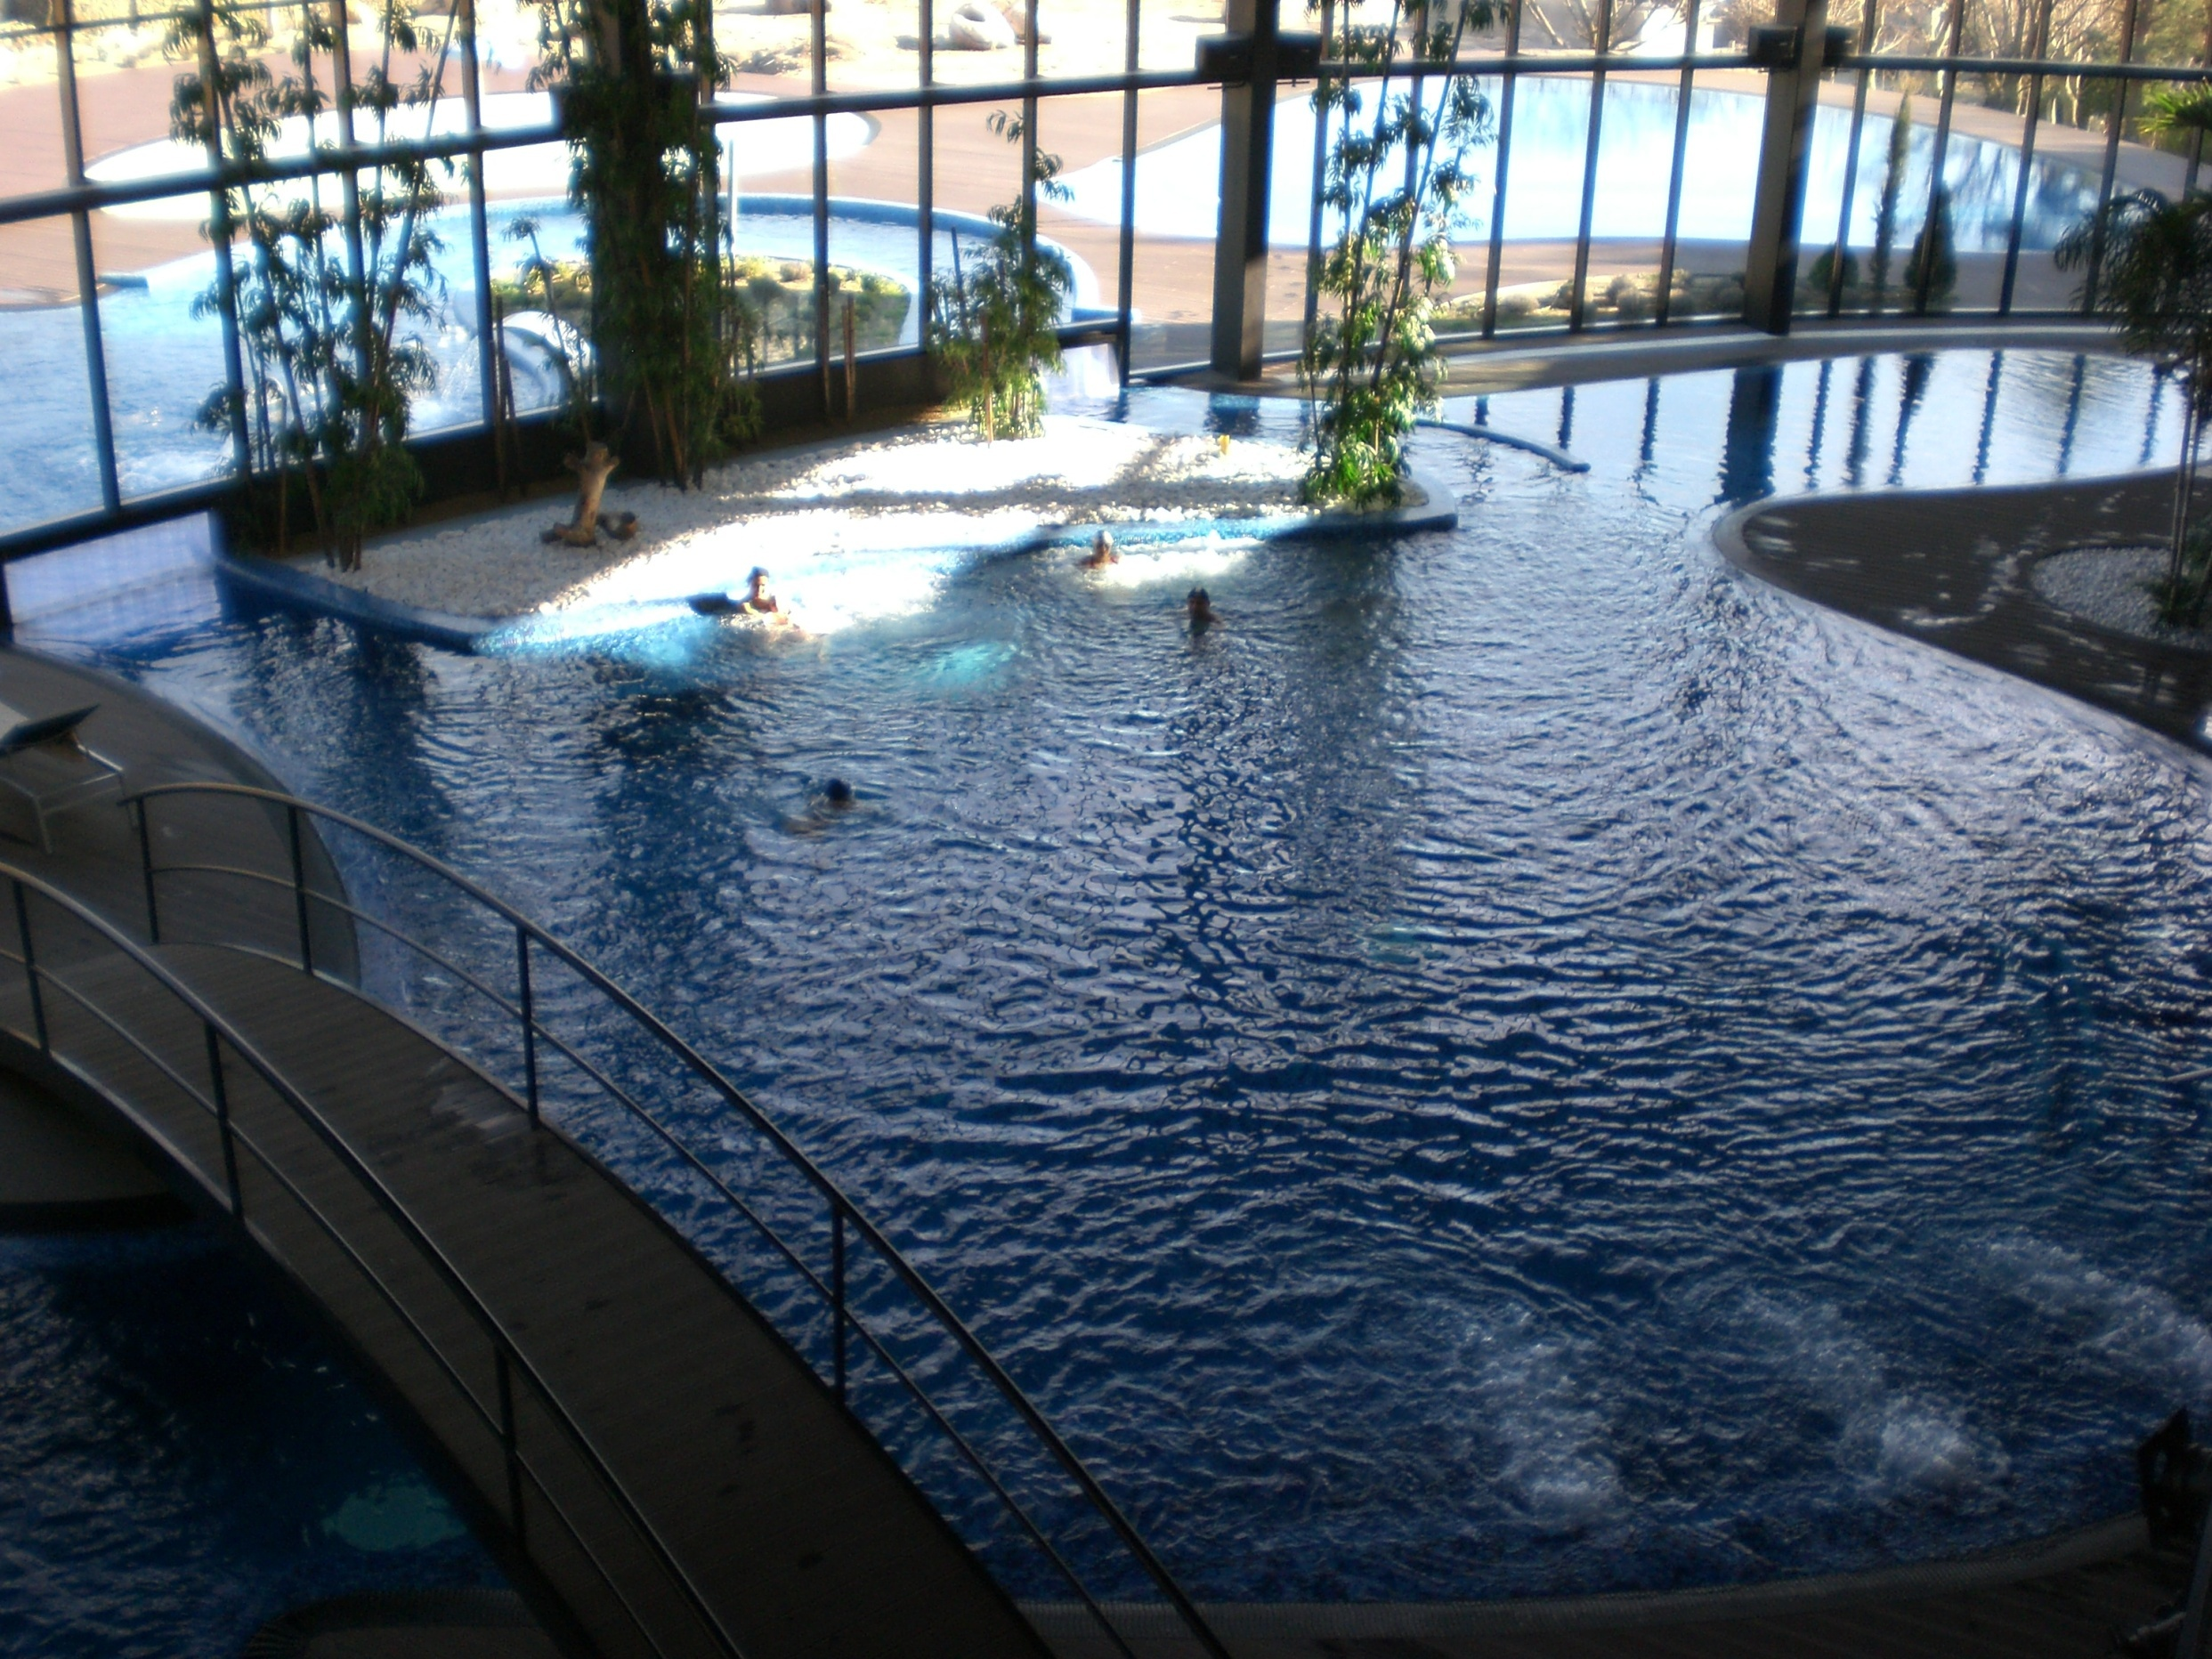

Slide 15
Scientific Society
Sociedade Portuguesa de Hidrologia Médica
e Climatologia
1952

Slide 16
Portuguese SPA Association

Slide 17
INDICATIONS (officially approved)
Musculoskeletal conditions
Respiratory tract
Dermatological
Digestive
Vascular
Metabolic
Neurologic
Psychiatric
(IN PORTUGAL THERMAL PRESCRIPTION IS A MEDICAL ACT)

Slide 18
STATISTICS
410 mineral water sources with therapeutic properties identified
round 50 exploitations are legalized
46 are working in 2019
Around of 125.000 clients in 2019
Social Thermalism returned
Pedro Cantista

Slide 19
COVID - 19 in Portuguese SPAs
COVID-19 was considered a pandemic on 11 March 2020 by the World Health Organization
In Portugal, public health measures have been implemented according to the various stages of the spread of the virus in response to the epidemic, in order to progressively decrease the transmission of SARS CoV-2, provide adequate health care to all patients and protect Public Health
When the Government, implementing the Decree of the President of the Republic of “State of Emergency in Portugal ”(Decree of the President of the Republic no. 14-A / 2020, of 18 March), approved a set of exceptional and temporary measures to respond to the disease, embodied in Decree No. 2- A / 2020, of March 20, determining the closure of the spas in Article 7,
But in fact all spas were already closed by initiative of Doctors and Owners of Portuguese SPAs stopping their activity in March 13.

Slide 20
REOPENING
With the evolution of the pandemic and the progressive scientific knowledge of the situation and some virus characteristics it was decided to study the possibilities of reopening the Thermal facilities and in which circumstances
A group of personalities was uncharged of this task by the Portuguese Authorities

Slide 21
ORIENTATION DRAWING GROUP
Frederico Teixeira MD, PhD
Pedro Cantista MD, PhD
Luís Cardoso de Oliveira MD, PhD
In preparing this Guideline, the contributions of the Technical-Scientific Commission of the Association of Termas de Portugal, an independent committee that includes specialists in the areas of medical hydrology and climatology, geology and microbiology, were taken into account, which were analysed and validated by the Portuguese Society of Medical Hydrology (Pedro Cantista) and by the Competence Committee on Hydrology and Climatology of the Ordem dos Médicos (Luis Cardoso Oliveira)

Slide 22
GUIDELINES
GUIDANCE
NUMBER: 031/2020
DATE: 6/13/2020
SUBJECT: COVID-19: Thermal establishments
KEYWORDS: Coronavirus; SARS-CoV-2; COVID-19; Thermal establishments.
FOR: Thermal establishments
CONTACTS: dspdps@dgs.min-saude.pt

Slide 23
COVID 19 Economic impact in Portugal
GROSS DOMESTIC PRODUCT (GDP) – a loss of 16.3%
UNEMPLOYMENT RATE - from 6.5 to 8.1% (only possible due to government special measures, like simplified lay-off and prohibition of dismissals)
EXPORT – a loss of 40%
IMPORT – also a lost, less 29%
UE SUPPORT – 6,5 thousand millions of euros

Slide 24
COVID -19 impact on Portuguese Balneology Activity
Closed officially in March 20
Reopening started in June 15
Number o SPAs in activity:
Before 46 Now 36
Number of thermalists:
Before: 123,000 Estimated this year 40,000
Income:
Before 14 million euros directly + 25 indirectly This year we preview a loss of 65-70%
Around 1500 workers

Slide 25
What About the Future?
I let this topic for the discussion…

Slide 26
Thank you very much pedro.cantista@gmail.com

